Slide 1
Cryptography
Tasneem Mirza

Slide 2
Cryptography
Cryptography : (Greek word)- Secret writing
The science and art of transforming messages to make them secure and immune to attacks
Components involved in cryptography :
Key Key
Plaintext :Original message before being transformed.
Ciphertext : Message after transformation.
Encryption : Process of transforming the plaintext into ciphertext.
Decryption : Process of transforming the ciphertext back into
plain text.
plaintext
ciphertext
plaintext
Encryption
Decryption

Slide 3
Cryptography
Cipher – Encryption and Decryption algorithms.
Key – A number or a set of numbers that the cipher (algorithm) operates on.
For the process of encryption
Input – Encryption algorithm, plaintext, key.
Output –Cipher text
For the process of decryption
Input – Decryption algorithm, ciphertext, key.
Output –Plain text
Notations used to describe the transformations :
C=E(P) C-ciphertext, P-plaintext, E-encryption algorithm
P=D(C) or
P=D(E(P)) D- Decryption algorithm.

Slide 4



Notations used in Security world
Bob, Alice want to communicate “securely”
Trudy (intruder) may intercept, delete, add messages
Alice
Bob
channel
data, control messages
secure
sender
secure
sender
secure
receiver
data
secure
receiver
data
Trudy

Slide 5
Common Terms
Cryptography
Means hidden writing, the practice of using encryption to conceal text
Cryptanalysis
Study of encryption and encrypted message, with the goal of finding the hidden meaning of the messages.
Both the cryptographer and the cryptanalyst attempt to translate the coded material back to it’s original form. But a cryptographer works on behalf of a legitimate sender or receiver, whereas a cryptanalyst works on behalf of an unauthorized interceptor.

Slide 6
Cryptography
Cryptographic algorithms
Symmetric key –
Same key is used for encryption and decryption.
Hence the key is called the shared secret key.
Symmetric key
(Shared secret key)
Asymmetric key
(Public key)

Slide 7
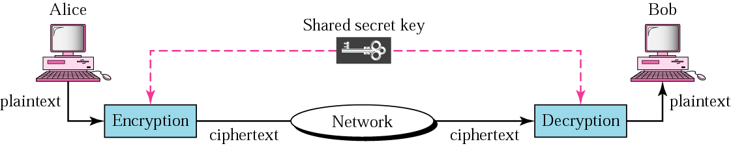
Symmetric Key encryption

Slide 8
Asymmetric Key encryption
Drawbacks of symmetric key :
Key must remain secret at both ends
In large networks, there are many keys pairs to be managed
Sound cryptographic practices dictates that the key be changed frequently
The shared secret key must be transmitted through an insecure transmission channel.
Asymmetric key encryption
Uses 2 keys public and private key
Public Key- known to all
Private key – known only to the receiver.

Slide 9
Asymmetric Key encryption
Every communicating entity creates 2 keys public and private.
Every communicating entity distributes it’s public key to every other entity and keeps it’s private key to itself.
If Alice wants to send a message to Bob, Alice encrypts the message with Bob’s public key and when Bob receives the message, it decrypts it with its own private key.

Slide 10
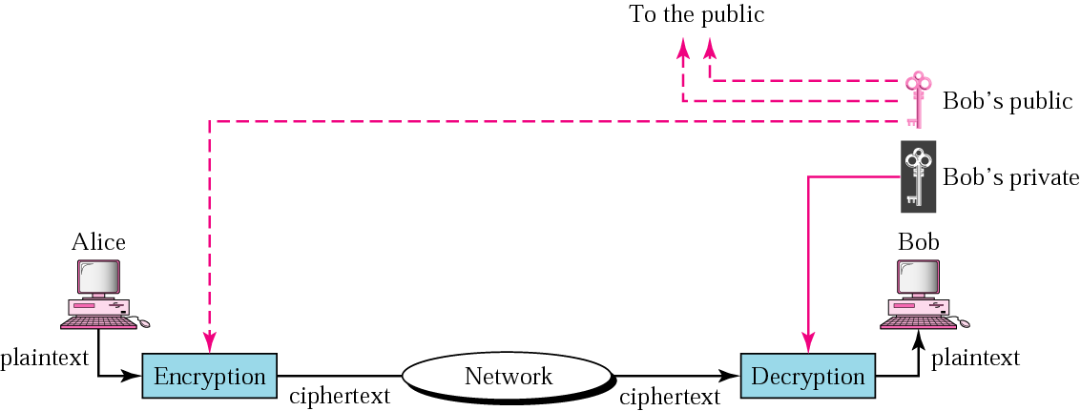
Asymmetric Key encryption

Slide 11
Two types of symmetric ciphers
Stream ciphers
Encrypts one bit/character at a time
Block ciphers
Break plaintext message in equal-size blocks
Encrypts each block as a unit

Slide 12
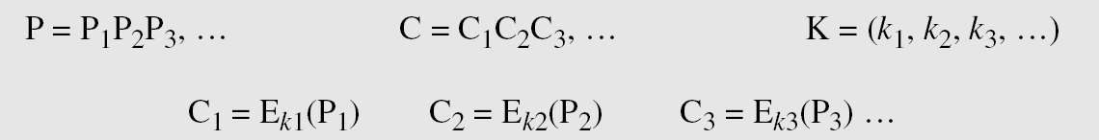
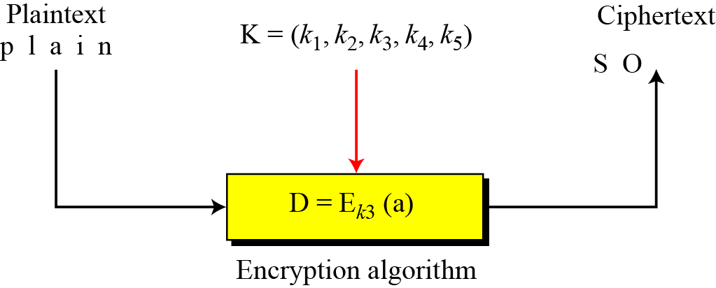
Stream and Block Ciphers
Stream cipher
Converts one symbol of plaintext into a symbol of ciphertext.
i.e Encrypts data symbol by symbol
Call the plaintext stream P, the ciphertext stream C, and the key stream K.

Slide 13
Stream and Block Ciphers
Keystream may be a stream of predetermined values or
May be created by an algorithm or can be a single value.
Note : Monoalphabetic cipher
k={k,k,k…….}

Slide 14
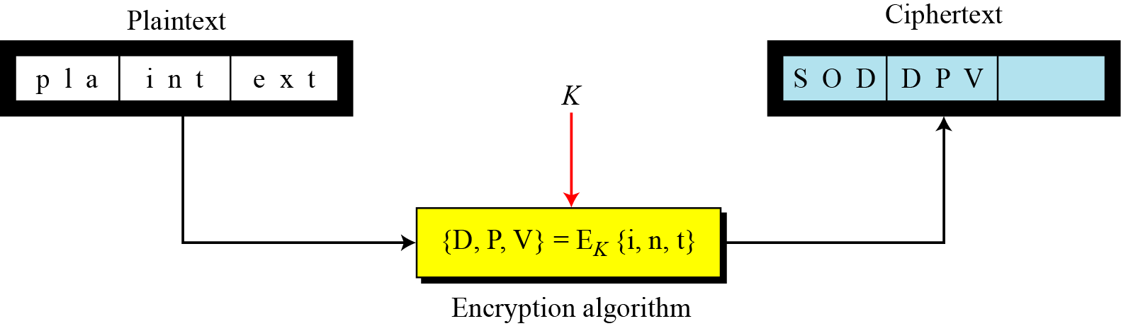
Stream and Block Ciphers
Block Cipher:
Encrypts a group of plaintext symbols to produce a group of
ciphertext symbols of the same size.
A single key is used to encrypt the block even if the key is made
up of multiple values.

Slide 15

Substitution Cipher
A substitution cipher replaces one symbol/character with another.
Monoalphabetic Cipher
Polyalphabetic Cipher
Monoalphabetic Cipher : (Stream cipher)
The letter is always replaced by the same alphabet regardless of its position in the text.
The relationship between a character in the plaintext to a character in the ciphertext is one –to- one.
If the algorithm says that letter A in the plain text is changed to letter D, then every letter A is changed to letter D.

Slide 16
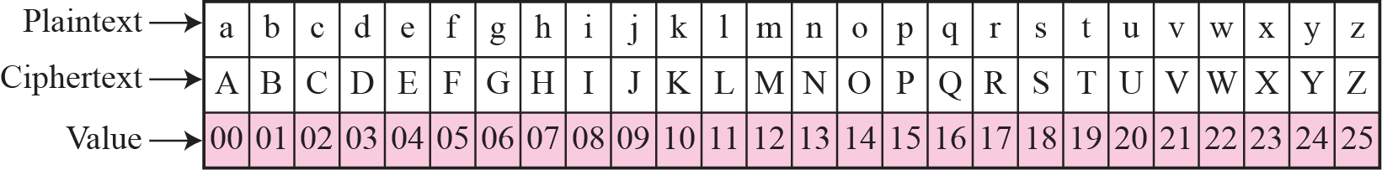
Substitution Cipher
Types of monoalphabetic cipher
1. Additive cipher
Also called as shift cipher.
A numerical value is assigned to each letter(upper/lower case)
The secret key is an integer in Z₂₆ ie from {0 to 25}
The encryption algorithm adds the key to the plaintext character.
The decryption algorithm subtracts the key from the
plaintext character.

Slide 17
Substitution Cipher
C=(P+k) mod 26
P=(C-k) mod 26
P= plaintext character
C= ciphertext character
k=key
Use the additive cipher with key = 15 to encrypt the message “hello”.
Note that the cipher is monoalphabetic because two instances of the same plaintext character (l) are encrypted as the same character (A).
Notes:
‹#›

Slide 18
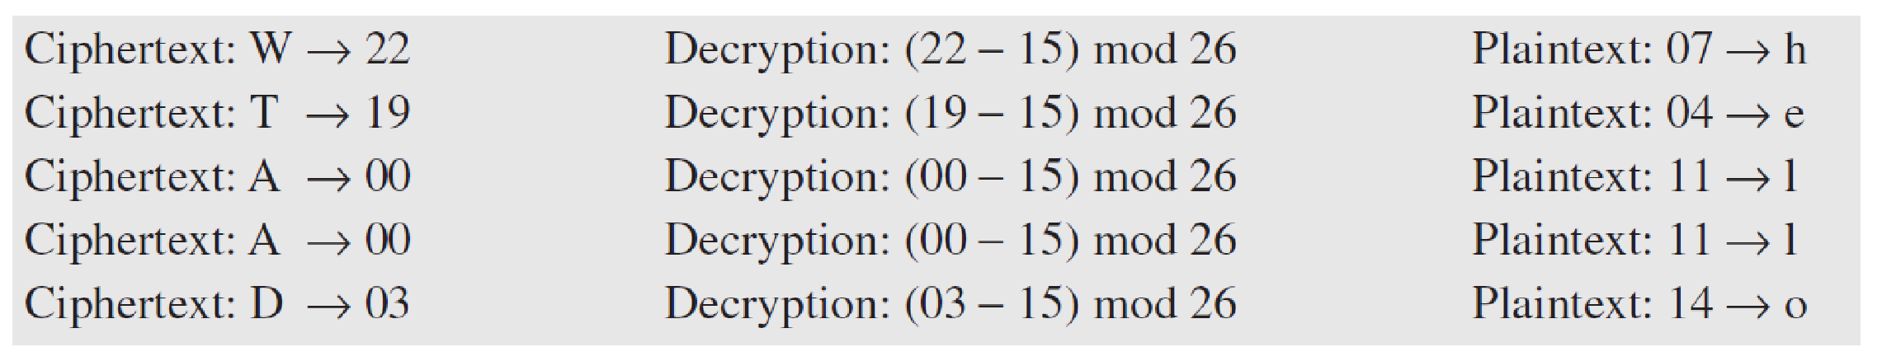
Substitution Cipher
Use the additive cipher with key = 15 to decrypt the message “WTAAD”.
Solution
We apply the decryption algorithm to the plaintext character by character. The result is “hello”. Note that the operation is in modulo 26, which means that we need to add 26 to a negative result (for example −15 becomes 11).

Slide 19
Substitution Cipher
2. Caeser Cipher
Julius Caeser used an additive cipher to communicate with
his officers.
Hence called Caeser’s cipher.
He used a key of 3 for his communications.

Slide 20
Substitution Cipher
3. Multiplicative ciphers
In multiplicative ciphers, the encryption algorithm specifies multiplication of the plaintext by the key and the decryption algorithm specifies the division of the ciphertext by the key.
However since opeartions are in Z_{26,} decryption here means multiplying the mutiplicative inverse of the key.
C=(P x k) mod 26
P=(C x K⁻¹) mod 26

Slide 21
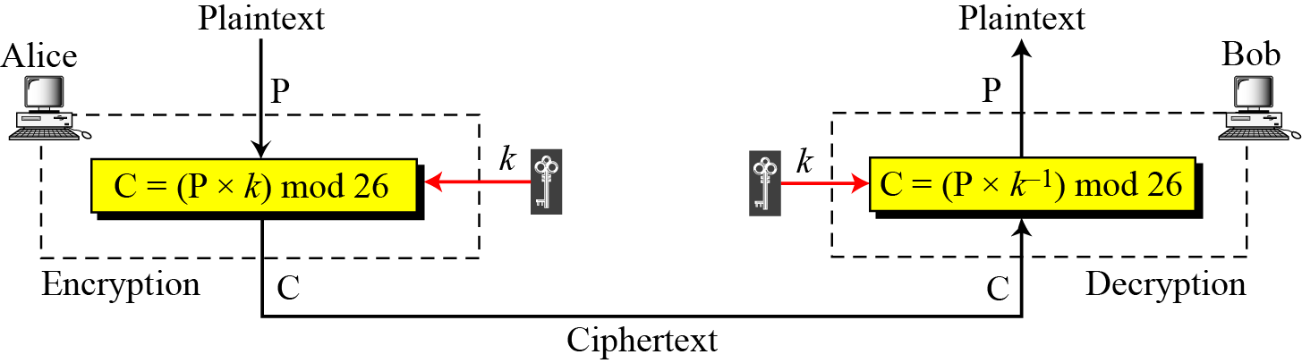

Slide 22
Modular multiplicative inverse
The modular multiplicative inverse of an integer a modulo m is an integer x such that
a.x mod m =1
OR
The multiplicative inverse of a in Z_{m} is x.
This no. x is between 0 to m-1.
For eg :
4 is the multiplicative inverse of 3 in Z₁₁-🡪
Since
4.3 mod 11=1

Slide 23
Modular multiplicative inverse
An integer may or may not have a multiplicative inverse.
We say that multiplicative inverse of a in Zm exists if gcd(a,m)=1.
Find the multiplicative inverse of 8 in Z₁₀.
There is no multiplicative inverse because gcd (10, 8) = 2 ≠ 1.
In other words, we cannot find any number between 0 and 9
such that when multiplied by 8 mod 10 =1.

Slide 24
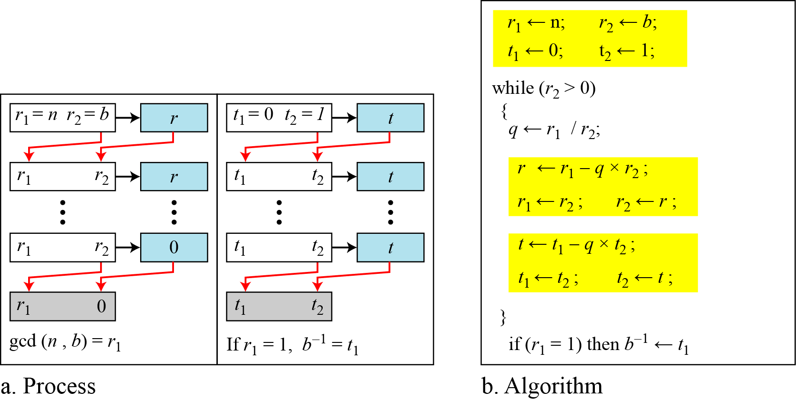
Modular multiplicative inverse
Using extended Euclidean algorithm to find multiplicative inverse
i.e find multiplicative inverse of b in zn

Slide 25
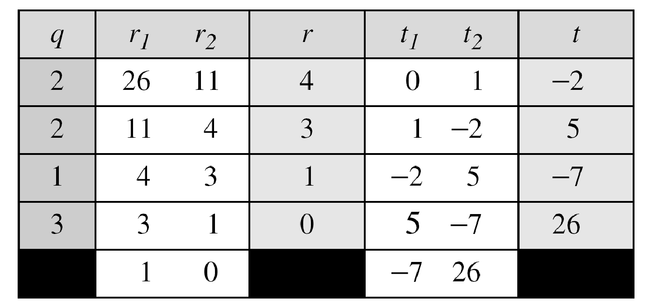
Modular multiplicative inverse
Find the multiplicative inverse of 11 in Z₂₆.
The gcd (26, 11) is 1; the inverse of 11 is −7 or 19.
11x19 mod 26 =1

Slide 26
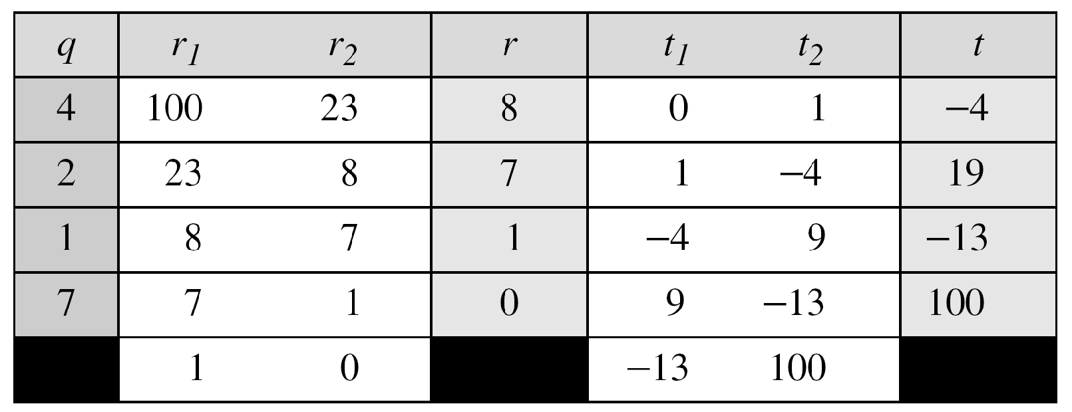
Find the multiplicative inverse of 23 in Z₁₀₀.
The gcd (100, 23) is 1; the inverse of 23 is −13 or 87.

Slide 27
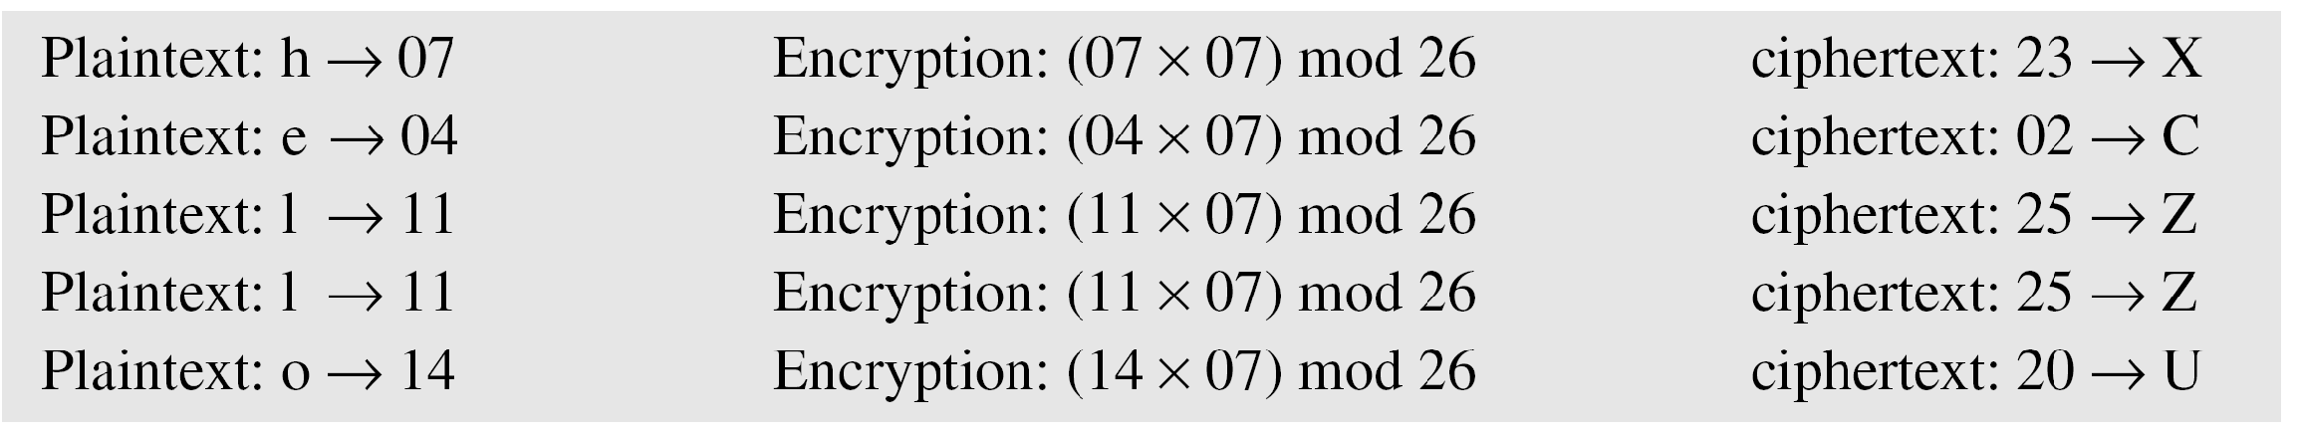
Substitution cipher
What is the key domain for any multiplicative cipher?
The key needs to be in Z₂₆. This set has only 12 members: 1,
3, 5, 7, 9, 11, 15, 17, 19, 21, 23, 25.
Use multiplicative cipher to encrypt the message “hello”
with a key of 7. The ciphertext is “XCZZU”.

Slide 28
Substitution cipher(Monoalphabetic)
Decryption
Find the multiplicative inverse of 7 in Z₂₆.
Ans-15
To decrypt X---🡪
(23 x 15) mod 26= 7----h

Slide 29
Substitution cipher(Poly alphabetic)
B) Polyalphabetic cipher
Each occurrence of a character can have a different substitute.
The relationship between a character in the plaintext to a character in the ciphertext is one –to- many.
Eg : A could be changed to D in the beginning of the text , to N in the middle and so on.
The key here is a stream of subkeys.

Slide 30
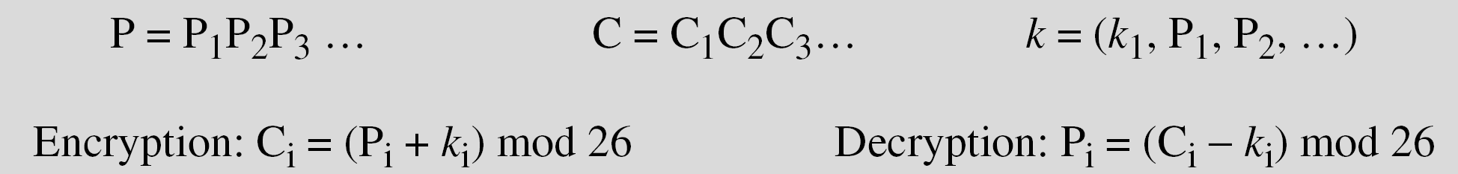
Substitution cipher(Poly alphabetic)
Types of Polyaphabetic cipher
Autokey cipher
Key is a stream of subkeys, in wich each subkey is used to encrypt the corresponding character in the plaintext.
The first subkey is a predetermined value secretly agreed upon by Alice and Bob.
The second subkey is the value of the first plaintext character(between 0 and 25).
The third subkey is the value of the second plaintext and so on.

Slide 31
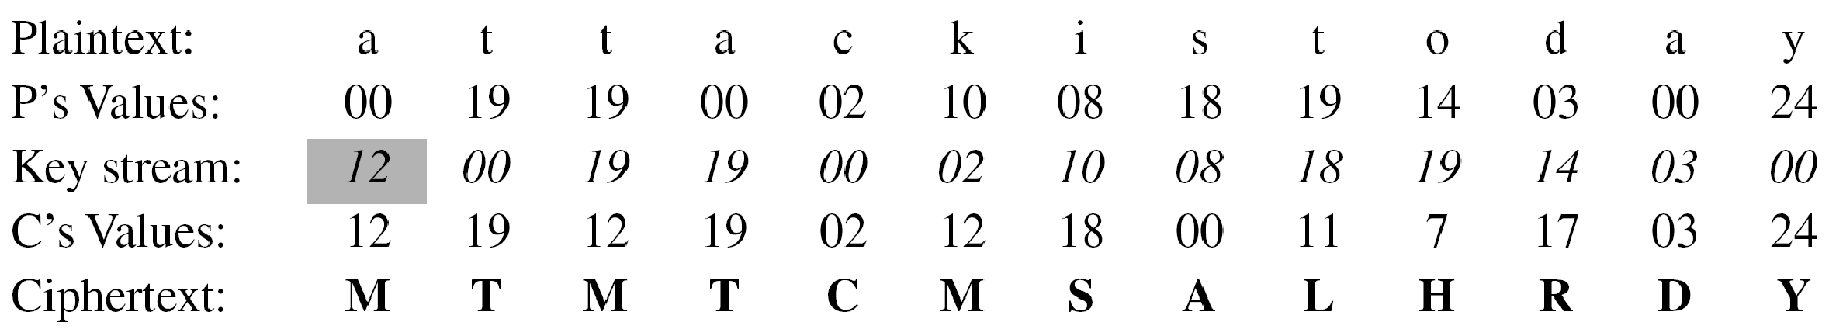
Substitution cipher(Poly alphabetic)
Assume that Alice and Bob agreed to use an autokey cipher with initial key value k1 = 12. Now Alice wants to send Bob the message “Attack is today”. Enciphering is done character by character.

Slide 32
Substitution cipher(Poly alphabetic)
2. Playfair cipher
Polyalphabetic cipher used by the British Army during World War I.
The secret key in this cipher is made of 25 letters arranged in a 5x5 matrix(letters I and J are considered the same when encrypting).
Different arrangements of the letters in the matrix can create many different secret keys.

Slide 33
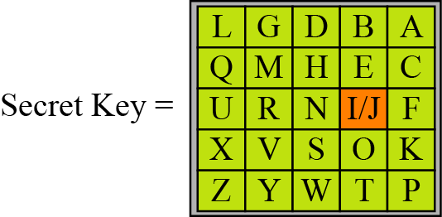
Substitution cipher(Poly alphabetic)
An example of a secret key in the Playfair
Cipher

Slide 34
Substitution cipher(Poly alphabetic)
Before encryption
If the 2 letters in a pair are the same, a bogus letter is inserted to separate them.
After inserting bogus letters, if the number of characters in the plaintext is odd, one extra bogus characters is added at the end to make the number of characters even.
Cipher rules for encryption :
1. If the 2 letters in a pair are located in the same row of the secret key, the corresponding encrypted character for each letter is the letter to the right in the same row(with wrapping to the beginning of the row if the plaintext letter is the last character in the row)

Slide 35
Substitution cipher(Poly alphabetic)
2. If the 2 letters in a pair are located in the same column of the secret key, the corresponding encrypted character for each letter is the letter beneath it in the same column(with wrapping to the beginning of the column if the plaintext letter is the last character in the column)
3. If the 2 letters in a pair are not in the same row/ same column of the secret key, the corresponding encrypted character for each letter is the letter that is in its own row but in the same column as the other letter

Slide 36
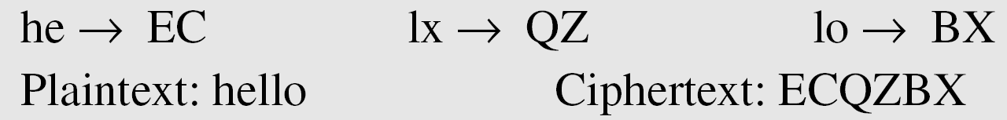
Substitution cipher(Poly alphabetic)
Encrypt the plaintext “hello” using the above key
The cipher is a polyalphabetic cipher since 2 occurences of the letter “l “are encrypted as “Q” and “B”

Slide 37
Substitution cipher(Poly alphabetic)
3. Vigenere cipher
The key stream is a repetition of an initial secret key stream of length m, where 1≤m≤ 26
P=P1 P2 P3……… C=C1 C2 C3…….
K=[(k1,k2,k3…..)(k1,k2,k3…….)]
Encryption Ci=Pi+ki Decryption Pi=Ci-Ki
Difference between Vignere and previous two polyalphabetic ciphers is that the key stream in Vignere cipher does not depend on the plaintext characters.
It depends only on the position of the character in the plaintext
i.e keystream can be created without knowing the plaintext

Slide 38
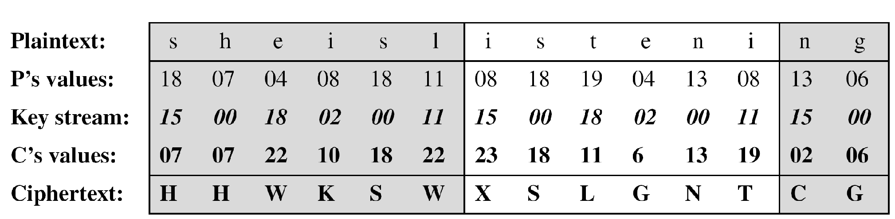
Substitution cipher(Poly alphabetic)
Encrypt the message “She is listening” using the 6-character keyword “PASCAL”. The initial key stream is (15, 0, 18, 2, 0, 11). The key stream is the repetition of this initial key stream (as many times as needed).
Additive cipher is a special case of Vignere cipher where m=1

Slide 39
Substitution cipher(Poly alphabetic)
4. One time pad (OTP) cipher(Vernam Cipher)
Devised by Gilbert Vernam for AT&T.
Immune to most cryptanalytic attacks.
Impossible to crack if used correctly. Hence also called perfect cipher.
Here each character from the plaintext is encrypted by a modular addition which a number from the secret random key pad which is of the same length as the plain ext.
Characteristics of OTP :
Key is truly random
Never reused
Kept secret.
Drawbacks :
Need of unlimited no. of keys
Overhead of distributing (sender and receiver) and storing the keys

Slide 40
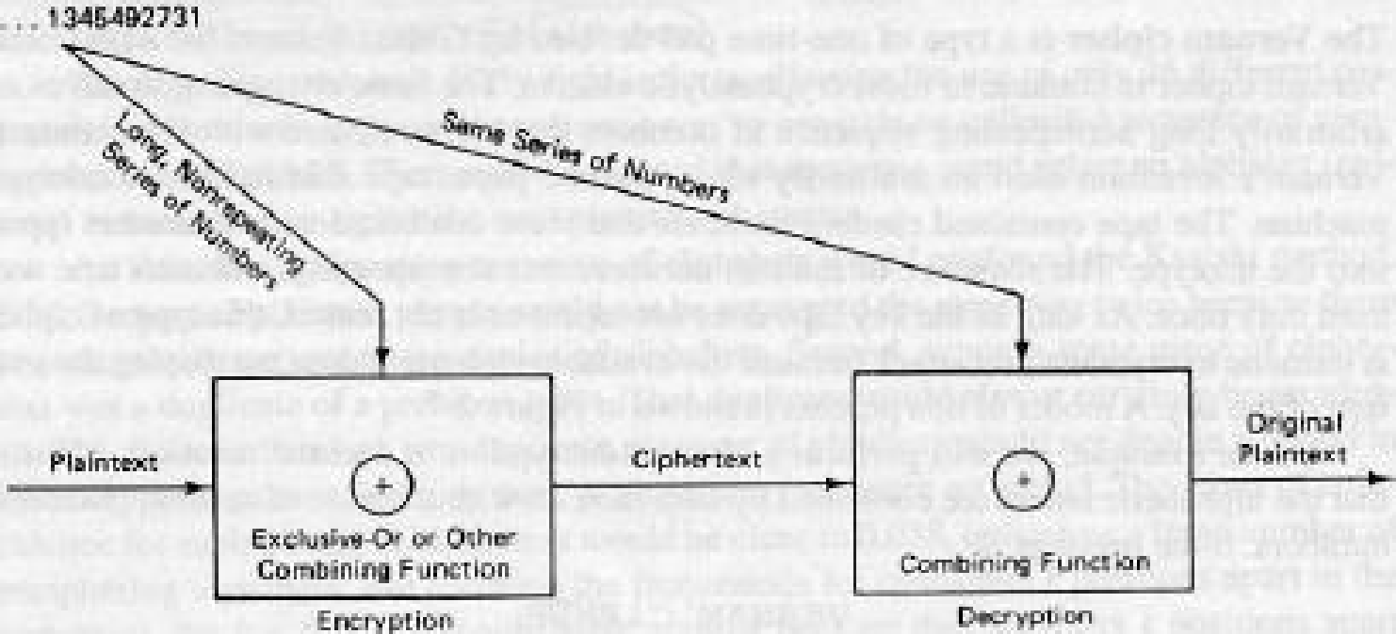
Substitution cipher(Poly alphabetic)
One such OTP is the Vernam cipher devised by Gilbert Vernam for AT&T.
Basic encryption involves an arbitrarily long non repeating sequence of numbers that are combined with the plain text.
Eg: Message to be encrypted---🡪
VERNAM CIPHER

Slide 41
Substitution cipher(Poly alphabetic)
Step 1: Convert the letters to their numeric equivalents
V E R N A M C I P H E R
21 4 17 13 0 12 2 8 15 7 4 17
Assume the random 2 digit no. series (key)
76 48 16 82 44 03 58 11 60 05 10 88
Step 2: Add the numeric equivalent and the corresponding random no.
Random no + numeric equivalent =sum
Sum 97 52 33 95 44 15 60 19 75 12 14 105

Slide 42
Substitution cipher(Poly alphabetic)
Step 3 : Perform sum mod 26
19 0 7 17 18 15 8 19 23 12 14 1
Ciphertext ----🡪
t a h r s p i t x m o b
Decryption
Step 1
a = (numeric equivalent of ciphertext - key)
Step 2
a mod 26
(if a negative then keep adding 26 till you get a positive no.)
Step 3
Convert numeric equivalent back to alphabet

Slide 43
Substitution cipher(Poly alphabetic)
Eg of decryption
t a h r s p i t x m o b
19 0 7 17 18 15 8 19 23 12 14 1
76 48 16 82 44 03 58 11 60 05 10 88
a= -57 -48 -9 -65 -26 12 -50 8 -37 7 4 -87
a mod 26
21 4 17 13 0 12 2 8 15 7 4 17
V E R N A M C I P H E R

Slide 44
Substitution cipher(Poly alphabetic)
Eg 2 plaintext H E L L O
7 4 11 11 14
key 23 12 2 10 11
(Msg+ key) 30 16 13 21 25
(Msg+ key) mod 26 4 16 13 21 25
E Q N V Z ---🡪 CIPHERTEXT
Decryption
4 16 13 21 25
key 23 12 2 10 11
(Ciphertext-key) -19 4 11 11 14
(Ciphertext-key) mod 26 7 4 11 11 14
H E L L O -----🡪 Plaintext

Slide 45
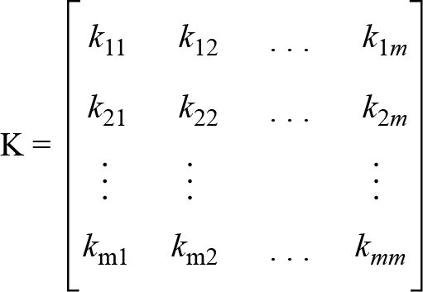
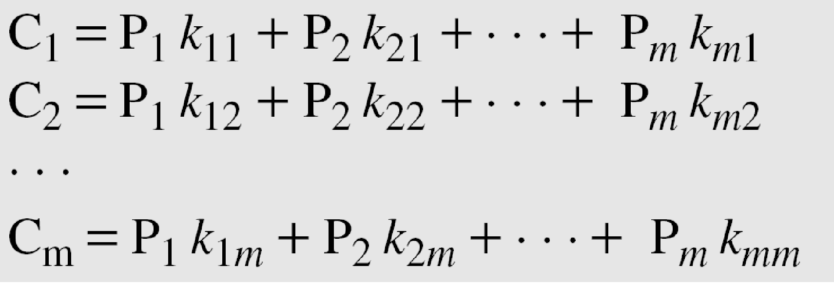
Substitution cipher(Poly alphabetic)
5. Hill cipher
Invented by Lester S. Hill
The plaintext is divided is divided into equal sized blocks.
Hence Hill cipher is a block cipher.
In Hill cipher, the key is a square matrix of size mxm where m is the size of the block.
The key matrix in the Hill cipher needs to have a multiplicative inverse.

Slide 46
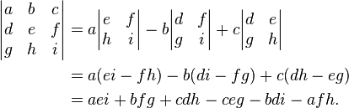
Substitution cipher(Poly alphabetic)
Assume block size is 3
Hence key matrix is 3 x 3
Let K= 2 3 15
5 8 12
1 13 4
The key matrix should have a multiplicative inverse
How to find?
Find the determinant of the key i.e
2(8x4-13x12)-3(5x4-12x1)+15(5x13-8x1)=583
583 mod 26=11, gcd(11,26)=1

Slide 47
Substitution cipher(Poly alphabetic)
Hence matrix is invertible mod 26
Assume text to be encrypted is CRYPTOGRAPHY.
C R Y P T O G R A P H Y
2 17 24 |15 19 14| 6 17 0 | 15 7 24
P = 2 15 6 15
17 19 17 7
24 14 0 24
Encryption --🡪
(K.P ) mod 26 =
2 3 15 2 15 6 15 25 11 11 21
5 8 12 17 19 17 7 = 18 5 10 3 =C
1 13 4 24 14 40 2 7 6 19 20
C= 25 18 7 11 5 6 11 10 19 21 3 20
Notes:
‹#›

Slide 48
Substitution cipher(Poly alphabetic)
Decryption
Decryption Key K⁻¹
To find K⁻¹ (USING THE ADJOINT METHOD)
K= 2 3 15
5 8 12
1 13 4
Step 1 Find cofactor of matrix K
+ - +
+ -
+ - +
For finding new K11- 8x4 – 12x13 = -124
For finding new K12- -(5x4 – 12x1) = -8
For finding new K13- 13x5 – 8x1 = 57

Slide 49
Substitution cipher(Poly alphabetic)
For finding new K21- -(4x3– 15x13)= 183
Co factor matrix - -124 -8 57
183 -7 -23
-84 51 1
Step 2 Adjoint is obtained by taking the transpose of the
cofactor matrix
-124 183 -84
-8 -7 51
57 -23 1
Step 3 Find the det(k) mod 26 =11
Step 4 Find the multiplicative inverse of 11 in Z₂₆ = 19

Slide 50
Substitution cipher(Poly alphabetic)
Step 5 Multiply 19 by the adjoint matrix
-124 183 -84
19x -8 -7 51
57 -23 1
= -2356 3477 1596
-152 -133 969
1083 -437 19
Taking mod 26 we get the inverse K⁻¹
K⁻¹ = 10 19 16
4 23 7
17 5 19

Slide 51
Substitution cipher(Poly alphabetic)
To decrypt P=K⁻¹xC
P=
10 19 16 25 11 11 21
4 23 7 18 5 10 3
17 5 19 7 6 19 20
= 704 301 604 587
563 201 407 293 mod 26
648 326 598 752
P = 2 15 6 15
17 19 17 7
24 14 0 24
P = C R Y P T O G R A P H Y
2 17 24 15 19 14 6 17 0 15 7 24

Slide 52
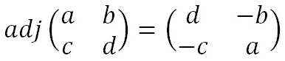
Substitution cipher(Poly alphabetic)
Hill cipher for a 2x2 matrix
Step 1 : Find the determinant of the matix
Step 2 :Check if the multiplicative inverse of the determinant exists. If exists compute the multiplicative inverse
Step 3 : Find the Adjugate Matrix The adjugate matrixis a matrix of the same size as the original. For a 2 x 2 matrix, it is just moving the elements to different positions and changing a couple of signs. That is, we swap the top left and bottom right numbers in the key matrix, and change the sign of the the top right and bottom left numbers. Algebraically this is given below.

Slide 53
Substitution cipher(Poly alphabetic)
Step 4 : Multiply the Multiplicative Inverse of the determinant by the Adjugate Matrix
Step 5 : Take the anwers in modulo 26 which gives us the inverse of the matrix.

Slide 54
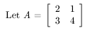
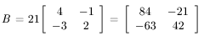
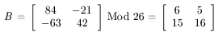
Modular Reciprocal Example

Slide 55
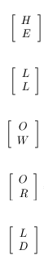
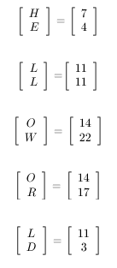
Change Message to Vectors
Message to encrypt = HELLO WORLD

Slide 56
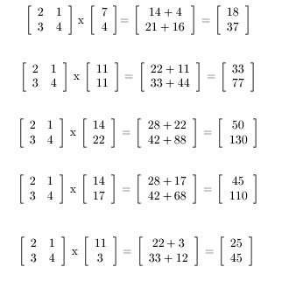
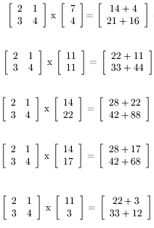
Multiply Matrix by Vectors

Slide 57
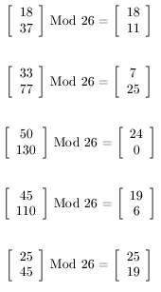
Convert to Mod 26

Slide 58
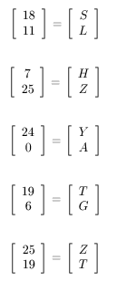
Convert Numbers to Letters
HELLO WORLD has been encrypted to
SLHZY ATGZT

Slide 59
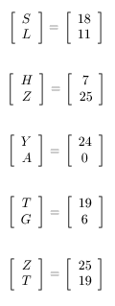
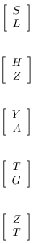
Change Message to Vectors
Message to decrypt = SLHZYATGZT

Slide 60
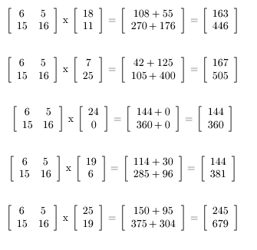
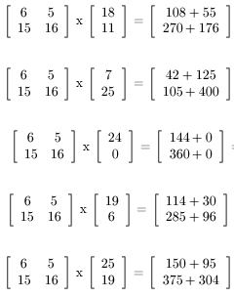
Multiply Matrix by Vectors

Slide 61
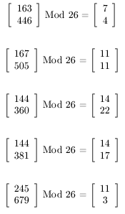
Convert to Mod 26

Slide 62
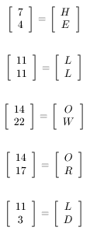
Convert Numbers to Letters
SLHZYATGZT has been decrypted to
HELLO WORLD

Slide 63
Transposition cipher
3. Transposition cipher (Block cipher)
Substitution cipher - Plaintext letters were replaced by other letters
Transposition ciphers use the letters of the plaintext message, but they permute the order of the letters(reorders letters)
Key is a mapping between the position of the symbols in the plaintext and cipher text.
Types
Keyed transposition cipher
Keyless transposition cipher

Slide 64
Transposition cipher
Keyed transposition cipher
(Assume a block of 4 characters)
Plaintext 2 4 1 3
Ciphertext 1 2 3 4
In encryption we move the character at position 2 to position 1,
character at position 4 to 2 and so on.
Eg: Encrypt : hello my dear
Remove spaces
Divide the text into blocks of 4 characters.
Add bogus character(s) at the end.
hell omyd earz
Ciphertext: elhl mdoy azer
After decryption : hell omyd earz

Slide 65
Cryptanalysis of a transposition cipher
Difficult
A brute force attack would involve trying possible arrangements of the letters until the word is determined.
For a 5 letter word there are 5!=120 ways to arrange five distinct letters, and exactly one of them should result in a word.

Slide 66
Transposition cipher
2. Keyless transposition cipher
Rearrangement of the characters of the plain text into columns.
Eg: 5 column transposition
Here the plaintext is written in rows of 5 and arranged one row after another --🡪
c1 c2 c3 c4 c5
c6 c7 c8 c9 c10
c11……
The resulting ciphertext is formed by reading down the
columns.

Slide 67
Transposition cipher
Eg: plaintext -🡪 THIS IS A MESSAGE HI TSEC
T H I S I
S A M E S
S A G E H
I T S E C
CIPHERTEXT--- TSSIH AATIM GSSEE EISHC
For decryption – Arrange the characters in 4 rows and 5
columns.
Note :When the message length not a multiple of 5 then add
infrequent letter x at the end.

Slide 68
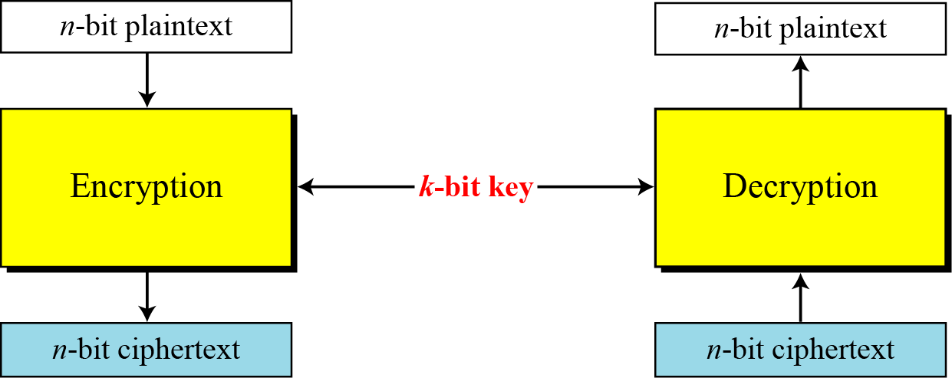
Block Cipher
With the advent of computer –What we need is bit oriented protocols.
Since information to be encrypted is not just text but can be numbers, graphics, audio and video data.

Slide 69
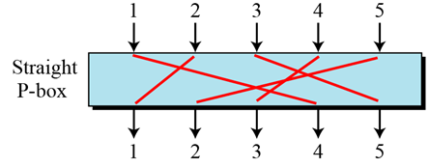
Components used by a modern block cipher
Components used by a modern block cipher :
1. D-box /P- box(diffusion box/permutation box)
Parallels the transposition cipher for characters.
It transposes bits.
3 types of D-boxes :
a) Straight D-box
Box with m inputs and n outputs where m=n

Slide 70
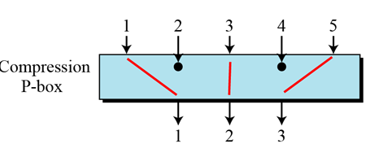
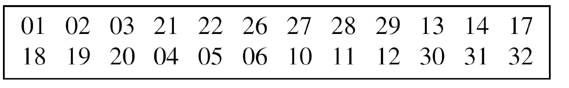
Components used by a modern block cipher
b) Compression D-box
Box with m inputs and n outputs where m>n.
Some of the inputs are blocked and do not reach the output.
Eg : 32 x 24 Compression D- box

Slide 71
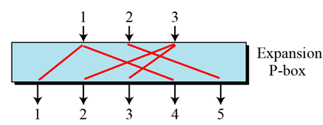
Components used by a modern block cipher
c) Expansion D-box
A box with m inputs and n outputs where m<n
Eg :12 x 16 Expansion D-box

Slide 72
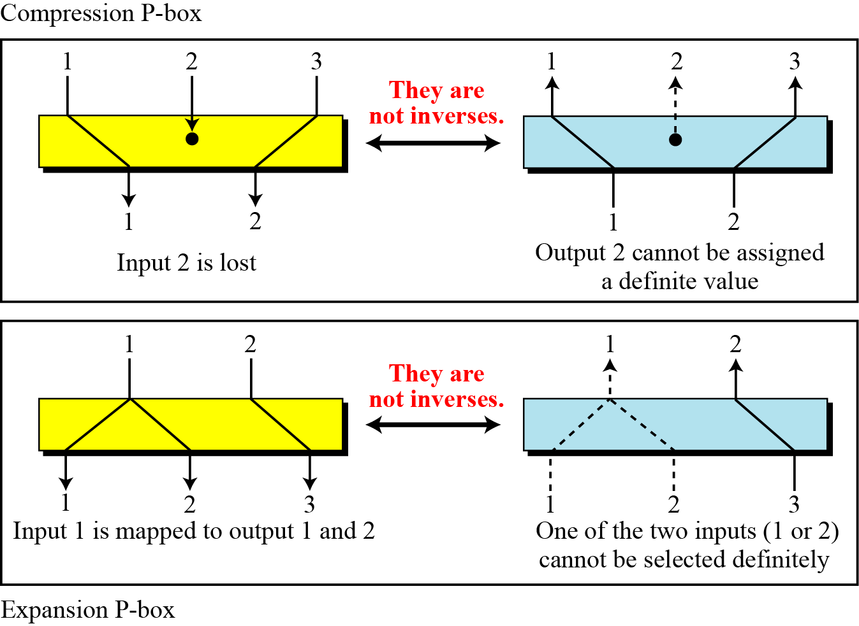
Components used by a modern block cipher

Slide 73
Components used by a modern block cipher
2. Substitution box (S-box)
Input to an S box is a stream of bits with length N, the result is another stream of bits with length M.
M and N need not be the same.
Used in the intermediate stage in the process of encryption and decryption.
The function that matches input to the output is defined by a table.

Slide 74
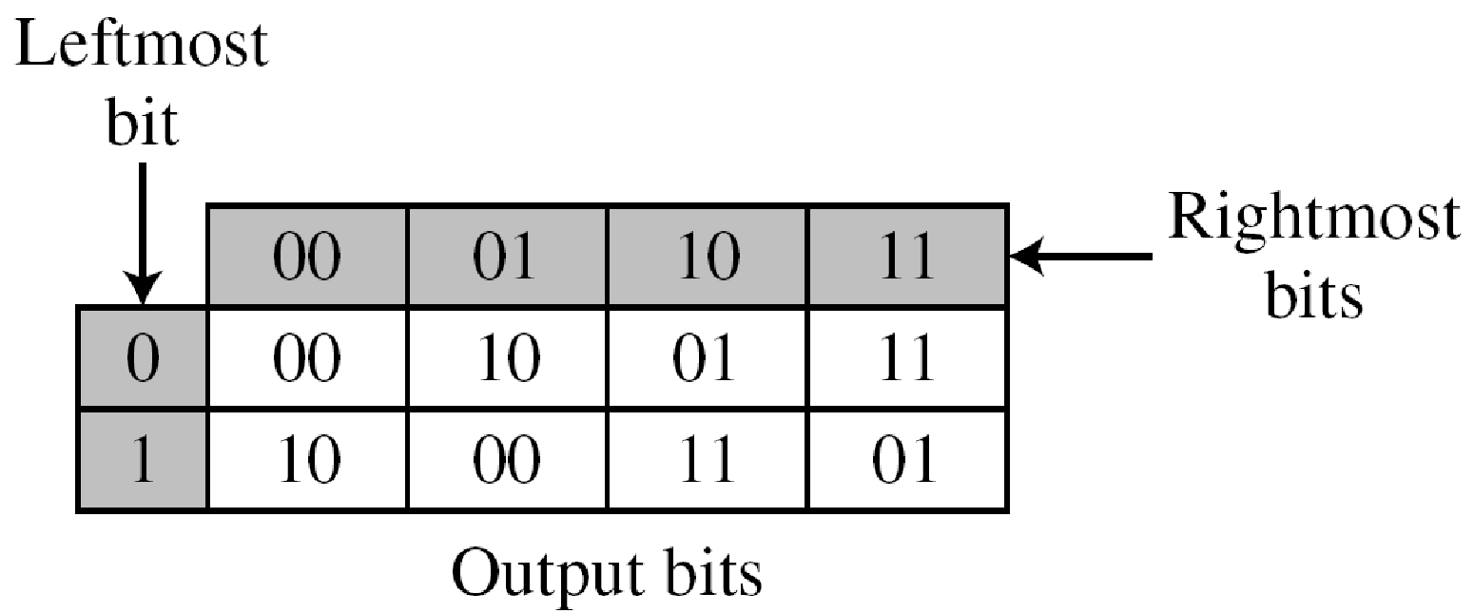
Components used by a modern block cipher
Eg :of a 3 x 2 S-box
Based on the table, an input of 010 yields the output 01
An input of 101 yields the output of 00.

Slide 75
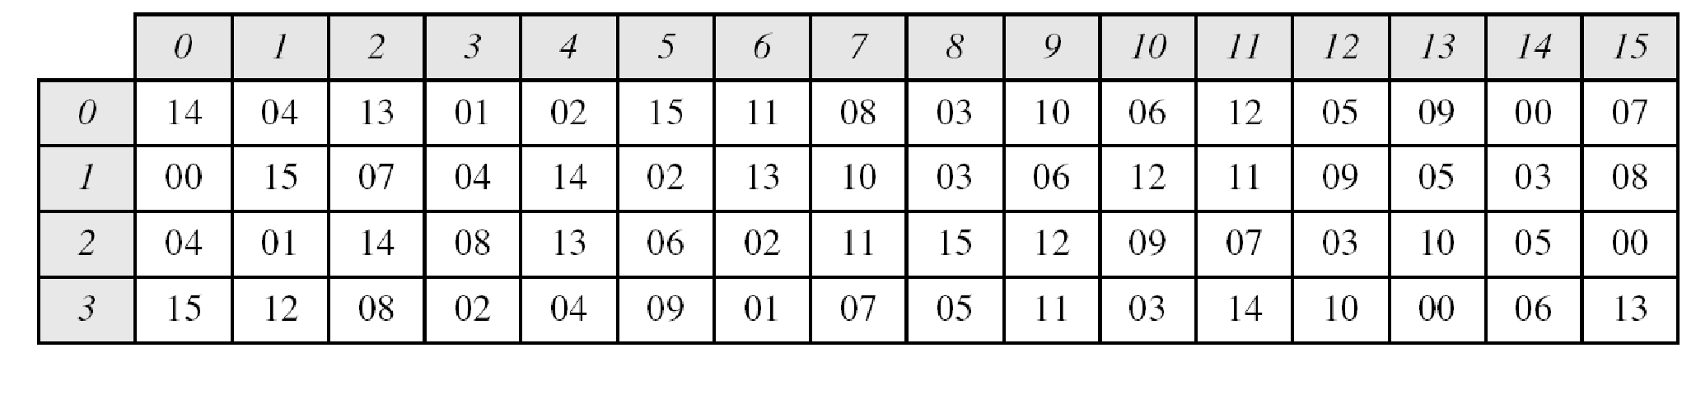
Components used by a modern block cipher
Eg 6 x 4 S-box
First an the last bits select the row. Middle 4 select the column
The input to S-box 8 is 000000. What is the output?
O/p- 1110
The input to S-box 1 is 100011. What is the output?
O/p- 1100

Slide 76
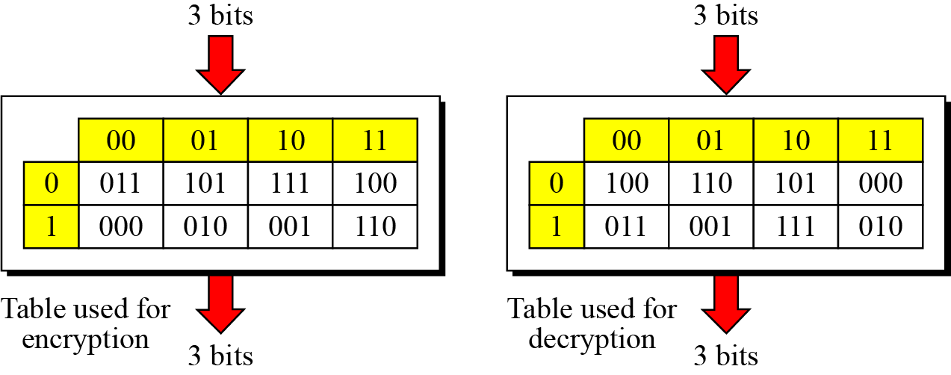
Components used by a modern block cipher
An S-box may or may not be invertible. In an invertible S-box, the number of input bits should be the same as the number of output bits.
For example, if the input to the left box is 001, the output is 101. The input 101 in the right table creates the output 001, which shows that the two tables are inverses of each other.

Slide 77
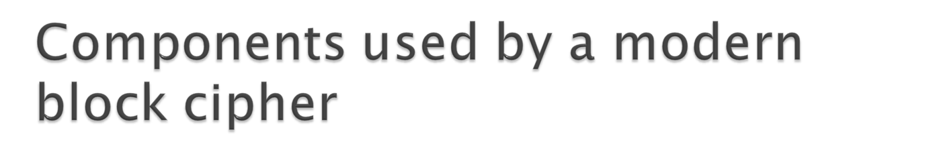
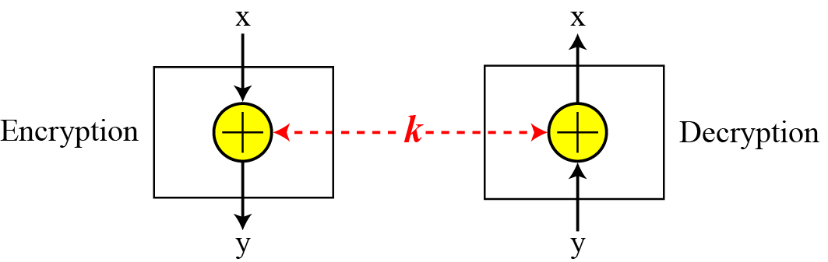
3. XOR
An important component in most block ciphers is the
exclusive-or operation.

Slide 78
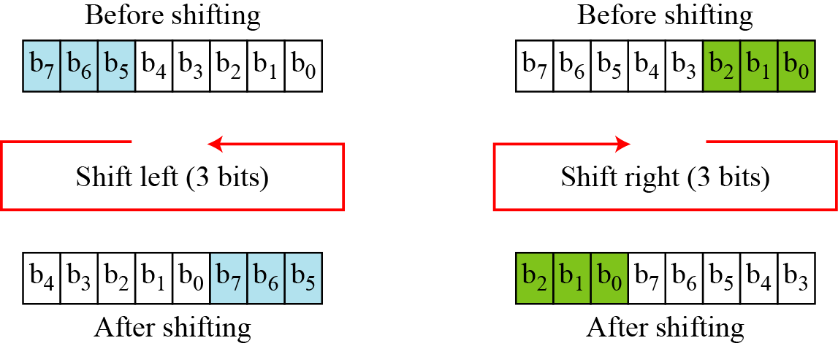
4. Rotation
Another component found in some modern block ciphers is the
circular shift operation.

Slide 79
Properties of a good cipher
1. Diffusion
Hides the relationship between the ciphertext and the plaintext.
This will frustrate the interceptor who uses the ciphertext to
find the plain text.
It implies that each symbol (char/bit) in the ciphertext is dependent on some or all symbols in the plaintext.
OR
If a symbol in the plaintext is changed several or all symbols in the ciphertext will also be changed.
In a cipher with good diffusion , o/p should depend on the input symbols in a very complex way.

Slide 80
Properties of a good cipher
2. Confusion
Hides the relationship between the ciphertext and the key.
This will frustrate the interceptor who tries to use the ciphertext to find the key.
If a single bit in the key is changed most or all bits in the ciphertext will also change.

Slide 81
Modern block ciphers
Product Ciphers
A product cipher is a complex cipher combining substitution, permutation and other simple ciphers.
Iterated product ciphers are used to achieve diffusion and confusion.
Each iteration is referred to as a round.
A key generator creates different keys for each round from the cipher key.
In an N round cipher, the plaintext is encrypted N times to create the ciphertext and the ciphertext is decrypted N times to create the plaintext.
Eg: 2 round product cipher

Slide 82
Product ciphers
3 transformations happen at each round :
The 8 bit text is mixed with the key to whiten the text(hide the bits using the key). i.e. EXOR 8 bit word with the 8 bit key.
The output of the whitener are organized into 2 bit groups and fed into 4 S-boxes. The values of bits are changed based on the structure of the S-box.
The outputs of S-boxes are passed to the P-box(Straight) which transposes the bits so that in the next round each box receives different input.

Slide 83
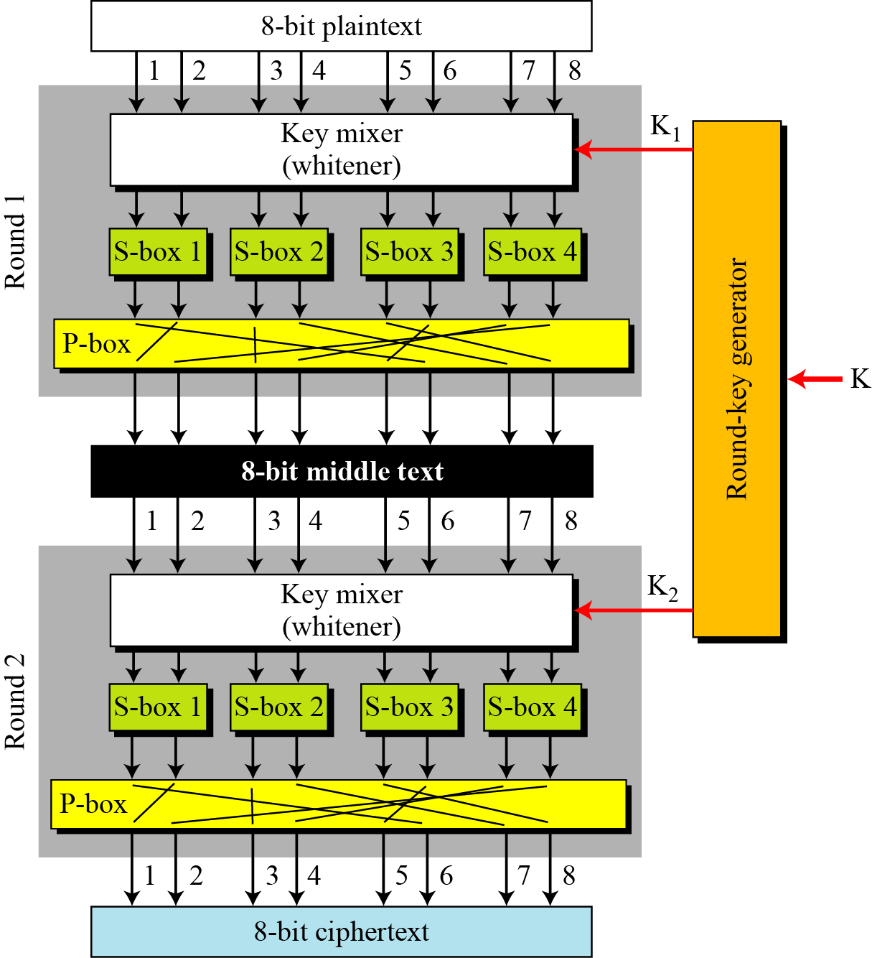


Slide 84
Product ciphers
How is diffusion achieved?
i.e. changing a single bit in the plaintext affects many bits in
the ciphertext.
1. In the first round bit 8, after being EX-ored with the corresponding bit of K1 affects 2 bits( 7 and 8) thru s-box 4. Bit 7 is permuted and becomes bit 2; bit 8 is permuted and becomes bit 4.
After the first round bit 8 has affected bits 2 and 4.
2. In the second round bit 2 after being Ex-ored with the corresponding bit in K2 affects 2 bits (bits 1 and 2) through S-box.
Bit 1 is permuted and becomes bit 6; bit 2 becomes bit 1.
Bit 4 after being Ex-ored with the corresponding bit in K2 affects bits 3 and 4. Bit 3 remains same, 4 becomes 7.
Hence after the second round bit 8 has affected bits 1,3,6,7.

Slide 85
Product ciphers
How is confusion achieved?
The 4 bits of ciphertext 1,3,6,7 are affected by 3 bits in the key
(bit 8 in K1 and bit 2 and 4 in K2)
Note : To improve confusion and diffusion practical ciphers use larger data blocks , more S boxes, and more rounds

Slide 86
Product ciphers
Modern block ciphers are all product ciphers, but they are divided into two classes.
1. Feistel ciphers :
A Feistel cipher can have three types of components: self-invertible, invertible, and noninvertible.
Eg: DES
2. Non-Feistel ciphers :
Consists of only invertible components. Eg: AES

Slide 87
Feistal ciphers
A Feistel cipher can have three types of components: self-invertible, invertible, and noninvertible.
How are encryption and decryption algos. inverse of each other if each has a non- invertible unit?
Eg of a non invertible component
Assume that the function takes the first and third bits of the
key, interprets these two bits as a decimal number, squares the
number, and interprets the result as a 4-bit binary pattern.
f(101) ---- The function extracts the first and third bits to get
11 in binary or 3 in decimal. The result of squaring is 9, which
is 1001 in binary.
f(101)= 1001
This function is non invertible.

Slide 88

The first thought in Feistel cipher design
In encryption , a non invertible function f(k) accepts the key as the input.
The o/p of this component is Ex-ored with the plaintext to get the ciphertext.
Combination of the function and the Ex-or is called the mixer.
Key K is the same.

Slide 89

Product ciphers
The plaintext and ciphertext are each 4 bits long and the key is 3 bits long. Assume that the function takes the first and third bits of the key, interprets these two bits as a decimal number, squares the number, and interprets the result as a 4-bit binary pattern. Show the results of encryption and decryption if the original plaintext is 0111 and the key is 101.
Solution
The function extracts the first and third bits to get 11 in binary
or 3 in decimal. The result of squaring is 9, which is 1001 in
binary.

Slide 90
Product ciphers
The function f(101)=1001 is non invertible, but the Exor operation allows us to use the function in both encryption and decryption.
Function is non-invertible but the mixer is self invertible.

Slide 91

Improvement of the previous Feistel design
In the initial feistal design only the key is input to the function.
Improvement –Let part of the plaintext in the encryption and part of the ciphertext in the decryption be also the input to the function.
Key is the second input to the function.
Inputs to the funtion should be exactly the same in encrp. and decryp
Hence right side of PT in encrp and right side of CT in decry must be the same

Slide 92

Assume L3=L2 and R3=R2(i.e no change in ciphertext during transmission)
R4=R3=R2=R1
L4=L3 ⊕ f(R3,K)
=L2 ⊕ f(R2,k)
=L1 ⊕ f(R1,k) ⊕ f(R1,k) =L1
L4=L1

Slide 93
Final Feistal cipher design
Drawback of the previous design :
The right side of the plaintext does not undergo encryption.
Improvement
Increase the no. of rounds/iterations.
Add a new element to each round , a swapper which swaps the left and right halves in each round.

Slide 94

Final design of a Feistel cipher with two rounds
Note : Instead of f(R5,K1) it is f(L5,K1)

Slide 95

Prove L6=L1 and R6=R1 if L4=L3 and R4=R3
First we prove L5=L2 and R5=R2
L5=R4 ⊕ f(L4,K2)
=R3 ⊕ f(R2,K2)
L5=L2 ⊕ f(R2,K2) ⊕ f(R2,K2) = L2
R5= L4=L3=R2
L6=R5 ⊕ f(L5,K1)
=R2 ⊕ f(L2,K1)
L6=L1 ⊕ f(R1,K1) ⊕ f(R1,K1)=L1
R6=L5=L2=R1

Slide 96

Data Encryption Standard
Modern symmetric key block cipher
Published by National Institute of standards and technology(NIST).
Encryption and decryption with DES

Slide 97

The encryption process is made of two permutations (P-boxes), which we call initial and final permutations, and sixteen Feistel rounds.
Each round uses a different 48 bit round key generated from the 56- bit cipher key.

Slide 98

Initial and final permutation steps in DES

Slide 99

Initial and final permutation tables
Each of these permutations take 64 bit input and permutes the bits according to a predefined rule. Eg in the initial permutation 58th bit in the input becomes bit no 1 and so on…

Slide 100
Rounds
DES uses 16 rounds. Each round of DES is a Feistel cipher.
Each round has 2 cipher elements :
Mixer
Swapper
Each of these is invertible.
The mixer is invertible because of the Xor operation.
All the non invertible elements are collected inside f(Ri-1,ki)

Slide 101

A round in DES

Slide 102
DES function
Heart of DES
Input to DES function🡪
1. 48 bit Key
2. Rightmost 32 bits
Output ->
32 bit output
DES function is made up of 4 sections.
1. Expansion Box
2. Whitener(XOR)
3. Group of S-boxes
4. A straight P-box

Slide 103

DES function

Slide 104

DES function
1. Expansion P- box
Since R_{I−1} is a 32-bit input and K_{I} is a 48-bit key, we first need to expand R_{I−1} to 48 bits.
R_{I−1} is divided into 8 4-bit sections
Each 4-bit section is expanded to 6 bits in the following manner :
Input bits 1,2,3,4 are copied to output bits 2,3,4,5 respectively.
O/p bit 1 comes from the input bit 4 of the previous section.
O/p bit 6 comes from input bit 1 of the next section.

Slide 105

DES function
Expansion P-box table

Slide 106
DES function
2. Whitener(XOR)
After the expansion permutation, DES uses the XOR operation
on the expanded right section and the round key.
Note : Both the right section and the key are 48-bits in length.
The 48-bit output goes as input to the S-box.
3. S-boxes
DES uses 8 S-boxes, each with a 6-bit input and a 4-bit output.
Substitution follows a predetermined rule :
Outer 2 bits of the 6 bit input select the row.
Inner 4 bits select the column.

Slide 107

DES function

Slide 108
DES function
Note : Each S-box has its own table
S box 1

Slide 109

DES function
4. Straight P-box

Slide 110
Key Generation
The round-key generator creates sixteen 48-bit keys out of a 56-bit cipher key.
The cipher key is actually a 64-bit key in which 8 extra bits are the parity bits which are dropped before the actual key generation process.
Process :
1. Parity Drop :
Parity drop step is called the compression transposition step.
Step 1 : Drop the parity bits (bits 8,16,24,32,40,48,56,64) from the 64-bit key.

Slide 111

Key Generation
Step2 : Permute the bits according to 🡪

Slide 112

Key generation

Slide 113

Key Generation
2. Shift left :
Key is divided into 2 parts and each part is shifted left (circular) 1 or 2 bits; depending on the round.
The 2 parts are then combined to form a 56-bit part.
3. Compression box :
Changes 56 bits to 48 bits which are used as a key for a round.

Slide 114
Triple DES
The DES algorithm itself had become obsolete and was in need of replacement.
To this end, the National Institute of Standards and Technology (NIST) ratified the Advanced Encryption Standard (AES) as a replacement for DES.
Triple DES had been endorsed by NIST as a temporary standard to be used until AES was finished.
Triple DES uses a "key bundle" which comprises three DES keys, K₁, K₂ and K₃, each of 56 bits (excluding parity bits)
Each triple encryption encrypts one block of 64 bits of data.

Slide 115
Triple DES
The encryption algorithm is:
ciphertext = E_{K3}(D_{K2}(E_{K1}(plaintext)))
i.e., DES encrypt with K₁, DES decrypt with K₂, then DES encrypt with K₃.
Decryption is the reverse:
plaintext = D_{K1}(E_{K2}(D_{K3}(ciphertext))) I.e., decrypt with K₃, encrypt with K₂, then decrypt with K₁

Slide 116
Triple DES
K1
K2
K3
A
B
E
D
E
P
C
(a) Encryption
K3
K2
K1
B
A
D
E
D
C
P
(b) Decryption

Slide 117
Triple DES
Keying options
The standards define three keying options:
Keying option 1:
All three keys are independent.
Keying option 2:
K₁ and K₂ are independent, and K₃ = K₁.
Keying option 3: All three keys are identical, i.e. K₁ = K₂ = K₃.
Note : Keying option 1 is the strongest, with 3 × 56 = 168
independent key bits.
Keying option 2 provides less security, with 2 × 56 =
112 key bits.
Keying option 3 is equivalent to DES, with only 56 key bits
because the first and second DES operations cancel out

Slide 118

The Advanced Encryption Standard (AES) is a symmetric-key block cipher published by the National Institute of Standards and Technology (NIST) in December 2001.
AES is a non-Feistel cipher that encrypts and decrypts a data block of 128 bits.
It uses 10, 12, or 14 rounds.
The key size, which can be 128, 192, or 256 bits, depends on the number of rounds.
But the round keys are always 128 bits.
3 versions are : AES - 128
AES - 192
AES - 256
Notes:
‹#›

Slide 119


Notes:
‹#›

Slide 120

Notes:
‹#›

Slide 121
Structure of AES
The 128 bit block of plaintext (16 bytes) is organized as a 4 x 4 matrix called the state
Hence we have s[0,0]……s[3,3]
i.e if inputs are 16 bytes (bo, b1……..b15)
They are represented as
s(i,j)
i-🡪 0-3 bo b4 b8 b12
j-🡪0-3 b1 b5 b9 b13
b2 b6 b10 b14
b3 b7 b11 b15
Notes:
‹#›

Slide 122

Notes:
‹#›

Slide 123

Each round consists of 4 operations :
Byte Substitution
Shift row
Mix column
Add round key
Notes:
‹#›

Slide 124

1. Byte Substitution
s(i,j) becomes s’(i,j) through a defined substitution table.
To substitute a byte, we interpret the byte as two hexadecimal digits.
Each byte b is replaced by another byte based on the sub bytes transformation table.
Notes:
‹#›

Slide 125

Notes:
‹#›

Slide 126

(00100000)₂ = (20)₁₆
This byte is replaced by B7 (i.e. row 2 and column 0)
Notes:
‹#›

Slide 127

In decryption we have Inverse Sub bytes transformation
Notes:
‹#›

Slide 128


The SubBytes and InvSubBytes transformations are inverses of each other.
Notes:
‹#›

Slide 129

2. Shift row
Each row of s’ undergoes a circular left shift.
Each row i is shifted left circular by i bytes where i 🡪 0-3
Notes:
‹#›

Slide 130


InvShiftRows
In the decryption, the transformation is called InvShiftRows and the shifting is to the right.
Notes:
‹#›

Slide 131

3. Mix columns
4 elements of each column are multiplied by a constant matrix
The MixColumns transformation operates at the column level; it transforms each column of the state to a new column.
Notes:
‹#›

Slide 132
Byte substitution changes the value of the byte based on the
original value and an entry in the table;changing a byte does
not affect the neighboring bytes.
Similarly shifting rows exchanges bytes without permuting the
bits inside the bytes.
But what we need is an interbyte transformation that changes
the bits inside the byte, based on the bits inside the
neighboring bytes.
i.e. we need to mix bytes to provide diffusion at the bit level.
This is done by taking 4 bytes at a time and combining them to
recreate 4 new bytes.
Notes:
‹#›

Slide 133

This is achieved by multiplying a square matrix(constant) by a column matrix, result is a new column matrix
Notes:
‹#›

Slide 134

Note :
Multiplying by 1 means leaving it unchanged
Multiplying by 2 means shifting each byte left 1 bit and exoring with 0001 1011 if the leftmost bit of the original value (before the shift) is 1
Multiplying by 3 means shift left one bit and ex-oring with the
original unshifted value and exoring with 0001 1011 if the leftmost bit of the original value (before the shift) is 1
InvMixColumns
The InvMixColumns transformation is basically the same as the MixColumns transformation.
The MixColumns and InvMixColumns transformations are inverses of each other.
Notes:
‹#›

Slide 135

InvMixColumns
The InvMixColumns transformation is basically the same as the MixColumns transformation.
The MixColumns and InvMixColumns transformations are inverses of each other.
Notes:
‹#›

Slide 136


After row shifting
Taking the first column
x
Notes:
‹#›

Slide 137

=
0110 0011 – after left shifting--- 1100 0110
1111 0010 ---- after left shifting--- 1110 0100 exor 1111 0010 exor 0001 1011
0111 1101 --- leave unchanged
1101 0100 --- leave unchanged
11 00 0110
0000 1101
0111 1101
1101 0100
0110 0010 (62)
Notes:
‹#›

Slide 138

Step 4 : Add round key
The final step is to ex-or the key with the result so far.
Notes:
‹#›

Slide 139

To create round keys for each round, AES uses a key-expansion process. If the number of rounds is N_{r} , the key-expansion routine creates N_{r} + 1 128-bit round keys from one single 128-bit cipher key.
The key expansion routine creates round keys word by word , where a word is an array of 4 bytes.
In the AES-128 version(10 rounds) there are 44 words.
In the AES-192 version(12 rounds) there are 52 words.
In the AES-256 version(14 rounds) there are 60 words.
Each round key is made up of 4 words
Notes:
‹#›

Slide 140


Notes:
‹#›

Slide 141

Creation of words from the original cipher key(128 bits)
Notes:
‹#›

Slide 142

The process is as follows :
The first four words( w0,w1,w2,w3) are made directly from the cipher key.
The cipher is an array of 16 bytes(k0 to k15). The first 4 bytes (k0 to k3) become w0; the next 4 bytes (k4 to k7) become w1; and so on. i.e the concatenation of first 4 words replicates the cipher key.
The rest of the words( wi for i=4 to 43) are made as follows:
1. If ( i mod 4) ≠ 0, w_{i}=w_{i-1} ⊕ w_{i-4}. i.e each word is made
from the one at the left and the top.
2. If ( i mod 4) = 0, w_{i}=t ⊕ w_{i-4}. Here t is a temporary word,
t is the result of applying 2 routines Subword and rotword on
w_{i-1} and exoring the result with a round constants RCon.
t= Subword ( Rotword( w_{i-1} ) ) ⊕ Rcon_{i/4}
Notes:
‹#›

Slide 143


Rotword : Rotate Word routine is similar to ShiftRows transformation, but it is applied to only one row. The routine takes a word as an array of 4 bytes and shifts each byte to the left with wrapping.
Subword : The Subword (Substitute word) routine is similar to the subBytes transformation , but is applied to only 4 bytes. The routine takes each byte in the word and substitutes another byte for it.
Notes:
‹#›

Slide 144
Following slide shows how the keys for each round are calculated assuming that the 128-bit cipher key agreed upon by Alice and Bob is (24 75 A2 B3 34 75 56 88 31 E2 12 00 13 AA 54 87)₁₆.
In each round , the calculation of the last three words are very simple. For the calculation of the first word we need to first calculate the value of the temporary word (t).
For example the first t for round 1 is calculated as----
24 75 A2 B3 34 75 56 88 31 E2 12 00 13 AA 54 87
w0 w1 w2 w3
Rotword(13 AA 54 87 ) = AA 54 87 13
Subword(AA 54 87 13) = AC 20 17 7D
t = AC 20 17 7D ⊕ 01 00 00 00 = AD 20 17 7D
To form w04 ---- w04= t ⊕ w_{i-4} = AD 20 17 7D ⊕ 24 75 A2 B3 = 89 55 B5 CE
Notes:
‹#›

Slide 145

Notes:
‹#›

Slide 146

S-box for key expansion

Slide 147
RC4 (Stream Cipher)
Most widely used stream cipher used to protect internet traffic and to secure wireless networks.
Designed by Ron Rivest in 1984.
Hence the name RC4( Rivest cipher 4).
8 bits of the plain text is Exored with a byte of the key to produce a byte of ciphertext.
Key stream is a a sequence of bytes( can contain 1-256 bytes).
Based on the concept of state. At each moment, a state of 256 byte is active from which one of the bytes is selected to serve as the key for encryption.
1. We have an array S ---🡪
S[0], S[1],S[2]…… S[255]
Notes:
‹#›

Slide 148

The contents of each element is also a byte ( 8 bits) that is an integer between 0 and 255.
2. There is an array key of length varying from 1 to 256 bytes. Typically between 5 and 16 bytes. Typically between 40-128 bits.
Note: S is initialized to the identity permutation.
RC4 consists of 2 phases:
Key scheduling algorithm( key setup phase)
Pseudo- random generation algorithm(Ciphering or XOR)
Notes:
‹#›

Slide 149

Use two array, state and key
1. 256-byte state table.
State[256]=[ 0 .. 255 ]
2. It has the capability of using keys between 1 and 256 bytes.
Key[1..256] = [ ……. ]
Notes:
‹#›

Slide 150

* Two phases
Key Setup
f = ( f + S_{i} + K_{g} ) mod n n🡪 no. bytes in state
Swapping S_{i} with S_{f}
Ciphering ( XOR )
i = ( i + 1 ) mod n , and f = ( f + S_{i} ) mod n
Swapping S_{i} with S_{f}
t = ( S_{i} + S_{f} ) mod n
Random byte S_{t}
Notes:
‹#›

Slide 151
Example (Key Setup phase)
We use 4 bytes state, and 2 bytes key for example.
S[]=[S0,S1,S2,S3]=[ 0, 1 ,2. 3]
K[]=[K0, K1]=[2,5]
Iteration 1:
i=0, f=0, g=0
S[ ]=[ S₀, S₁, S₂, S₃] = [ 0, 1, 2, 3 ]
K[ ]=[ K₀, K₁] = [ 2, 5 ]
Because f=( f + S₀ + K₀ )mod 4=2, then swap S₀ with S₂
New array S[ ]=[ S₀, S₁, S₂, S₃ ] = [ 2, 1, 0, 3]
i = i +1 = 1
g =(g+1)mod 2 = 1
Notes:
‹#›

Slide 152
Example (Key Setup phase)
Iteration 2:
i=1, f=2, g=1
S[ ]=[ S₀, S₁, S₂, S₃] = [ 2, 1, 0, 3 ]
K[ ]=[ K₀, K₁] = [ 2, 5 ]
Because f=( f + S₁ + K₁ )mod 4=0, then swap S₁ with S₀
New array S[ ]=[ S₀, S₁, S₂, S₃ ] = [ 1, 2, 0, 3 ]
i = i +1 = 2
g =(g+1)mod 2 = 0
Notes:
‹#›

Slide 153
Example (Key Setup phase)
Iteration 3:
i=2, f=0, g=0
S[ ]=[ S₀, S₁, S₂, S₃] = [ 1, 2, 0, 3]
K[ ]=[ K₀, K₁] = [ 2, 5 ]
Because f=( f + S₂ + K₀ )mod 4=2, then swap S₂ with S₂
New array S[ ]=[ S₀, S₁, S₂, S₃ ] = [ 1, 2, 0, 3]
i = i +1 = 3
g =(g+1)mod 2 = 1
Notes:
‹#›

Slide 154
Example (Key Setup phase)
Iteration 4:
i=3, f=2, g=1
S[ ]=[ S₀, S₁, S₂, S₃] = [ 1, 2, 0, 3 ]
K[ ]=[ K₀, K₁] = [ 2, 5 ]
Because f=( f + S₃ + K₁ )mod 4=2, then swap S₃ with S₂
New array S[ ]=[ S₀, S₁, S₂, S₃ ] = [ 1, 2, 3, 0 ]
Notes:
‹#›

Slide 155
Example (Ciphering phase)
* For this example we use plaintext “HI”
“H”:
i=0, f=0
S[ ]=[ S₀, S₁, S₂, S₃] = [ 1, 2, 3, 0 ]
Because i = ( i + 1 )mod 4 = 1
f = ( f + S₁ )mod 4 = 2, then swap S₁with S₂
New array S[ ]=[ S₀, S₁, S₂, S₃ ] = [ 1, 3, 2, 0 ]
Notes:
‹#›

Slide 156
Example (Ciphering phase)
t = ( S₁ + S₂ )mod 4 = 1
S₁ = 3 ( 0000 0011 )
H
0100 1000
XOR 0000 0011
0100 1011
Notes:
‹#›

Slide 157
Example (Ciphering phase)
“I”:
i=1, f=2
S[ ]=[ S₀, S₁, S₂, S₃] = [ 1, 3, 2, 0 ]
Because i = ( i + 1 )mod 4 = 2
f = ( f + S₂ )mod 4 = 0, then swap S₂with S₀
New array S[ ]=[ S₀, S₁, S₂, S₃ ] = [ 2, 3, 1, 0 ]
Notes:
‹#›

Slide 158
Example (Ciphering phase)
t = ( S₂ + S₀ )mod 4 = 3
S₃ = 0 ( 0000 0000 )
I
0100 1001
XOR 0000 0000
0100 1001
Result
Plaintext : 0100 1000 0100 1001
Cipher : 0100 1011 0100 1001
Notes:
‹#›

Slide 159

S={0,1,2,3}
K={1,7,1,7}
I st iteration
f=0, i=0, g=0
f=(0 + 0 +1) mod 4
f=1
Swap S0 with S1
New S={S0,S1,S2,S3} ---{1, 0, 2, 3}
i=i+1, g=(g+1) mod 4 =1
Notes:
‹#›

Slide 160
II nd iteration
f=1, i=1, g=1
f=(1 + 0 +7) mod 4
f=0
Swap S0 with S1
New S={S0,S1,S2,S3} ---{0, 1, 2, 3}
i=i+1, g=(g+1) mod 4 =2
Notes:
‹#›

Slide 161
III rd iteration
f=0, i=2, g=2
f=(0 + 2 +1) mod 4
f=3
Swap S2 with S3
New S={S0,S1,S2,S3} ---{0, 1, 3, 2}
i=i+1=3, g=(g+1) mod 4 =3
Notes:
‹#›

Slide 162
I V rth iteration
f=3, i=3, g=3
f=(3 + 2 +7) mod 4
f=0
Swap S3 with S0
New S={S0,S1,S2,S3} ---{2, 1, 3, 0}
Notes:
‹#›

Slide 163

1. Speed of Transformation
Stream – Each symbol is encrypted as soon as it is read. Hence
the time to encrypt the symbol depends only on the encryption
algorithm.
Block – The system has to wait until an entire block of plaintext
has been received before staring the encryption process.
Hence slowness of encryption.
2. Diffusion
Stream- Low diffusion
Each symbol is seperately enciphered. Therefore all the
information of that symbol is contained in one symbol of the
ciphertext.
Block- High diffusion
Information from the plaintext is diffused into several ciphertext
symbols.
Notes:
‹#›

Slide 164
3. Error Propagation
Stream – Low error Propagation
Because each symbol is seperately encoded, an error in the encryption
process affects only that character.
Block- High error Propagation
An error will affect the transformation of all other characters in the
same block.
4. Insertion of symbols
Stream- Susceptibility to malicious insertions and modifications.
Because each symbol is seperately enciphered , an active interceptor
who has broken the code can splice together pieces of previous
messages and transmit a spurious new message that may look may
authentic.
Block- Immunity to insertion of symbols.
Because blocks of symbols are enciphered, it is impossible to insert a
single symbol into one block. The length of the block would then be
incorrect, and the decipherment would quickly reveal the insertion.
Notes:
‹#›

Slide 165
Difference between Stream and Block Cipher
1. Speed of Transformation
Stream – Each symbol is encrypted as soon as it is read. Hence
the time to encrypt the symbol depends only on the encryption
algorithm.
Block – The system has to wait until an entire block of plaintext
has been received before staring the encryption process.
Hence slowness of encryption.
2. Diffusion
Stream- Low diffusion
Each symbol is seperately enciphered. Therefore all the
information of that symbol is contained in one symbol of the
ciphertext.
Block- High diffusion
Information from the plaintext is diffused into several ciphertext
symbols.

Slide 166
3. Error Propagation
Stream – Low error Propagation
Because each symbol is seperately encoded, an error in the encryption
process affects only that character.
Block- High error Propagation
An error will affect the transformation of all other characters in the
same block.
4. Insertion of symbols
Stream- Susceptibility to malicious insertions and modifications.
Because each symbol is seperately enciphered , an active interceptor
who has broken the code can splice together pieces of previous
messages and transmit a spurious new message that may look may
authentic.
Block- Immunity to insertion of symbols.
Because blocks of symbols are enciphered, it is impossible to insert a
single symbol into one block. The length of the block would then be
incorrect, and the decipherment would quickly reveal the insertion.

Slide 167
Asymmetric Key Cryptography

Slide 168
Difference between symmetric and asymmetric cryptography
1. In a community of n people ->
Symmetric- Key cryptography requires n(n-1)/2 shared secret keys
Asymmetric- key cryptography requires n personal secret keys are needed
2. Symmetric Key cryptography is based on sharing secrecy.
Asymmetric- key cryptography is based on personal secrecy.
3. Symmetric – Plain text and ciphertext are
symbols(bits/characters).
Asymmetric- Plaintext and ciphertext are numbers.
4. Symmetric-Encryption and decryption is based on
permutation and substitution of symbols.
Asymmetric- Encryption and decryption are mathematical functions

Slide 169

General idea of asymmetric key cryptography

Slide 170

Principles of public key cryptosystems

Slide 171
Plaintext/Ciphertext
Unlike in symmetric-key cryptography, plaintext and ciphertext are treated as integers in asymmetric-key cryptography.
Encryption/Decryption
C = f (K_{public} , P) P = g(K_{private} , C)
There is a very important fact that is sometimes misunderstood: The advent of asymmetric-key cryptography does not eliminate the need for symmetric-key cryptography.

Slide 172

Trapdoor One way function
The main idea behind asymmetric-key cryptography is the concept of the trapdoor one-way function.
Functions

Slide 173
Trapdoor One way function
One-Way Function (OWF)
f is easy to compute.
In other words, given x, y=f(x) can be easily computed
f ⁻¹ is difficult to compute.
In other words, given y, it is computationally infeasible to calculate x= f ⁻¹(y).

Slide 174
Trapdoor One way function
A trapdoor one-way function is a one-way function with a third
property :
3. Given y and a trapdoor(secret), x can be computed easily.
Public-key cryptosystems are based on trap-door one-way
functions.
The public key gives information about the particular instance
of the function; the private key gives information about the trap
door.
Whoever knows the trap door can perform the function easily in
both directions, but anyone lacking the trap door can perform
the function only in the forward direction.
The forward direction is used for encryption and the inverse
direction is used for decryption

Slide 175
Modular multiplicative inverse
The modular multiplicative inverse of an integer a modulo m is an integer x such that
a.x mod m =1
OR
The multiplicative inverse of a in Z_{m} is x.
This no. x is between 0 to m-1.
For eg :
4 is the multiplicative inverse of 3 in Z₁₁-🡪
Since
4.3 mod 11=1

Slide 176
Modular multiplicative inverse
An integer may or may not have a multiplicative inverse.
We say that multiplicative inverse of a in Zm exists if gcd(a,m)=1.
Find the multiplicative inverse of 8 in Z₁₀.
There is no multiplicative inverse because gcd (10, 8) = 2 ≠ 1.
In other words, we cannot find any number between 0 and 9
such that when multiplied by 8 mod 10 =1.

Slide 177
Modular multiplicative inverse
Using extended Euclidean algorithm to find multiplicative inverse
i.e find multiplicative inverse of b in zn

Slide 178
Modular multiplicative inverse
Find the multiplicative inverse of 11 in Z₂₆.
The gcd (26, 11) is 1; the inverse of 11 is −7 or 19.
11x19 mod 26 =1

Slide 179
Find the multiplicative inverse of 23 in Z₁₀₀.
The gcd (100, 23) is 1; the inverse of 23 is −13 or 87.

Slide 180

The first idea of public-key cryptography came from Merkle and Hellman called as Knapsack cryptosystem.
Definition
Suppose we are given two k-tuples,
a = [a₁, a₂, …, a_{k} ] and x = [x₁, x₂, …, x_{k}].
The first tuple is a predefined set; the second tuple in which xi is only 0 or 1, defines which elements of a are to be dropped in the knapsack.
Given a and x, it is easy to calculate s. However, given s and a it is difficult to find x.
Notes:
‹#›

Slide 181
In other words, s=knapsackSum(a,x) is easy to calculate, but x=inv_knapsackSum(s,a) is difficult.
The function knapsackSum is a one-way function if a is a general k-tuple.
Superincreasing Tuple
It is easy to compute knapsackSum and inv_knapsackSum if the k-tuple a is superincreasing.
a_{i} ≥ a₁ + a₂ + … + a_{i−1}
In other words, each element(except a1) is greater than or equal to the sum of all previous elements.
Notes:
‹#›

Slide 182

Notes:
‹#›

Slide 183

As an example, assume that a = [17, 25, 46, 94,201,400] and s = 272 are given.
Table shows how the tuple x is found using inv_knapsackSum routine in Algorithm
. In this case x = [0, 1, 1, 0, 1, 0], which means that 25, 46, and 201 are in the knapsack.
Notes:
‹#›

Slide 184

Key Generation (Done by Bob)
Create a superincreasing k-tuple b = [b¹, b², …… ,b^{k}]
Choose a modulus n, such that n > b¹+ b² + …. + b^{k}
Select a random integer r that is relatively prime with n and 1 <= r <= n-1
Create a temporary k-tuple t = [t¹ , t² , ….. t^{k}] in which t^{i} = r x b^{i} mod n
Select a permutation of k objects and find a new tuple a = permute(t)
The public key is the k tuple a. The private key is n, r, and the k-tuple b
Notes:
‹#›

Slide 185
Encryption Suppose Alice needs to send a message to Bob
1. Alice converts her message to a k-tuple x = [x¹, x² , …, x^{k}] in which x^{i} is either 0 or 1. The tuple x is the plaintext
2. Alice uses the knapsackSum(a,x) routine to calculate s. She then sends the value of s as the ciphertext
Decryption
Bob receives the ciphertext s
1. Bob calculates s’ = r⁻¹ x s mod n.
2. Bob uses inv_knapsackSum to create x’
3. Bob permutes x’ to find x. The tuple x is the recovered plaintext.
Notes:
‹#›

Slide 186

Notes:
‹#›

Slide 187


Notes:
‹#›

Slide 188

Note : 37⁻¹ in Z₉₀₀ is 73
Hence 2399 x 73 mod 900 =527
Notes:
‹#›

Slide 189
RSA
The most common public-key algorithm is the RSA cryptosystem, named for its inventors (Rivest, Shamir, and Adleman).
To generate the RSA public and private key pair-----🡪
Choose 2 large prime nos. p and q.
Form the product n=p.q
Find ф(n)=(p-1).(q-1)
Choose e such that it is relatively prime to ф(n).
Choose d such that : e x d mod ф(n)=1
(Or d is the multiplicative inverse of e in Z _{ф(n)} )

Slide 190

Public Key -- (e,n)
Private Key– d
Encryption and Decryption are accomplished via modular
exponentiation .
If M is the message :
Encryption --🡪
C= Me mod n
Decryption --🡪
M= C^{d} mod n

Slide 191


Slide 192
RSA
Example 1
Assume p=11 and q=3
n=11 x 3=33
ф(n)= 10 x 2 = 20
Let e be 3 ( prime to ф(n))
Choose d such that 3d mod 20 =1
Hence d=7
Public Key-----(3,33)
Private Key ----- 7
Let M =15
Encryption - C= 15³ mod 33 = 9
Decryption – M= 9⁷ mod 33=15

Slide 193
RSA
To make RSA secure recommended size of p and q is 512 bits(154 decimal digits).
This makes n 1024 bits.

Slide 194
RSA
Example 2
Let p=17 q=11
n=17 x 11 =187
ф(n)=16 x 10 =160
Let e=7
7d mod 160 =1
d=23
Let M=88
Encryption ---🡪
C=88⁷ mod 187
=[(88⁴ mod 187) x (88² mod 187) x (88 mod 187)] mod 187
88 mod 187 = 88
88² mod 187 = 7744 mod 187 = 77
88⁴ mod 187 = [(88² mod 187) x (88² mod 187) ] mod 187 =132
C= (132 x 77 x 88) mod 187 =894,432 mod 187 = 11
In the preceding example shows, we can make use of a property of modular arithmetic:
[(a mod n) * (b mod n)] mod n = (a * b) mod n

Slide 195
RSA
Decryption --🡪
M= 11²³ mod 187
11²³ mod 187 =[(11¹ mod 187) x (11² mod 187) x (11⁴ mod 187)
x 11⁸ mod 187 x 11⁸ mod 187 ) ] mod 187
11¹ mod 187=11
11² mod 187 =121
11⁴ mod 187 = 14641 mod 187 =55
11⁸ mod 187 = 33
11²³ mod 187 = [(11 x 121 x 55 x 33 x 33)] mod 187 = 88

Slide 196
Step 1. Choose two primes p and q.
Example: p = 5 and q = 13.
Step 2. Let n = pq.
n = 5×13 = 65. Step 3.
Let ф(n) = (p −1)(q −1). Example: ф(n) = 4×12 = 48.
Choose E = 11.
D = 35.
For example, to encrypt 3, we find
3^11 mod 65 =22
22^35 mod 65 =3

Slide 197

Symmetric Key distribution
Symmetric key distribution needs a shared secret key between 2 parties.
How are shared secret keys maintained and distributed?
Key distribution Centre : KDC
Use atrusted third party : KDC
Each person establishes a shared secret key with the KDC.

Slide 198
Symmetric Key distribution
A KDC creates a secret key for each member. This secret key
can be used only between the member and the KDC, not
between two members.
How can Alice send a confidential message to Bob?
Alice sends a request to the KDC stating that a session(temporary) secret key is needed so that Alice could communicate with Bob.
KDC informs Bob about Alice’s request.
If B agrees, a session key is created between the two.
One such protocol is KERBEROS
Note : K_{Alice} and K_{Bob} is used to authenticate Alice and Bob to the KDC to prevent Eve from impersonating either of them.

Slide 199
Diffie Hellman
2. Establishing a session keywithout using a KDC.
Alice and Bob can create a session key between themselves without using a KDC. This method of session-key creation is referred to as the symmetric-key agreement.
Eg: Diffie Hellman key agreement.
Here 2 parties need to choose 2 nos. p and g.
The first ‘p’ is a large prime no. i.e 300 decimal digits.
And the second no. g is the primitive root of the prime no. p

Slide 200
How to find a primitive root of a prime no. p ?
Let p be a prime no.
Then b is a primitive root for p if the first (p-1) powers of b are different.
Eg: If p=7
Is 2 a primitive root of 7 ? ---🡪
2⁰ mod 7 =1
2¹ mod 7 =2
2² mod 7=4
2³ mod 7= 1
2⁴ mod 7 =2
2⁵ mod 7 =4
2⁶ mod 7 =1
(p-1) values not different. Hence 2 is not a primitive root of 7

Slide 201
Is 3 a primitive root of 7 ? ---🡪
3⁰ mod 7 =1
3¹ mod 7 =3
3² mod 7=2
3³ mod 7= 6
3⁴ mod 7 =4
3⁵ mod 7 =5
3⁶ mod 7 =1
3⁷ mod 7 =3
3⁸ mod 7 =2
Hence 3 is a primitive root of 7
Note ; A prime no. can have a no. of primitive roots.
No repetition

Slide 202
Eg 2 : If p=13 --🡪
Is 2 a primitive root of 13 ?
1,2,4,8,3,6,12,11,9,5,10,7
no repetition
Hence 2 is a primitive root of 13.

Slide 203

Alice chooses a large random no. x such that 0<= x <= p-1 and calculates R1= g^{x} mod p.
Bob chooses another large random no. y such that 0<= y <= p-1 and calculates R2=g^{y} mod p.
Alice sends R1 to Bob. Alice does not send x; she only sends R1.
Bob sends R2 to Alice. Bob does not send y; he only sends R2.
Alice calculates K= (R2)^{x} mod p.
Bob calculates K= (R1)^{y} mod p.

Slide 204
Diffie Hellman
K is the symmetric key for the session.
K = (g^{x} mod p)^{y} mod p = (g^{y} mod p)^{x} mod p = g^{xy} mod p.
Both have reached the same value without Bob knowing value of x and without Alice kowing the value of y.
Eg: Assume (small nos. ) Let p=23 and g=7
Alice chooses x = 3 and calculates R₁ = 7³ mod 23 = 21.
Bob chooses y = 6 and calculates R₂ = 7⁶ mod 23 = 4.
Alice sends the number 21 to Bob.
Bob sends the number 4 to Alice.
Alice calculates the symmetric key K = 4³ mod 23 = 18.
Bob calculates the symmetric key K = 21⁶ mod 23 = 18.
The value of K is the same for both Alice and Bob; g^{xy} mod p = 7¹⁸ mod 23 = 18.

Slide 205
Diffie Hellman
Security of Diffie Hellman
Susceptible to 2 attacks :
Discrete logarithm attack
Man in the middle attack.
1.Discrete log attack :
Eve can intercept R1 and R2. If Eve can find x from R1=g^{x} mod p and y from R2=g^{y} mod p then she can calculate k=g^{xy} mod p
To make diffie Hellman secure ---🡪
Prime no. p must bvery large( 300 digits)
g must be a primitive root of p.
Bob and Alice must destroy x,y after they have calculated the symmetric key. The values of x and y must be used only once.

Slide 206
Diffie Hellman
2. Man in the middle attack
Eve does not have to know the value of y and x to attack the protocol.

Slide 207

Alice chooses x, calculates R1= g^{x} mod p and sends R1 to Bob.
Eve, intercepts R1. She chooses z, calculates R2=g^{z} mod p and sends R2 to both Alice & Bob.
Bob chooses y, calculates R3= g^{y} mod p and sends R3 to Alice. R3 is intecepted by Eve and never reaches Alice.
Alice and Eve calculate K1=g^{xz} mod p, which becomes the shared key between Alice and Eve. Alice however thinks that it is a shared key between Bob and herself.
5. Bob and Eve calculate K2=g^{zy} mod p, which becomes the shared key between Bob and Eve. Bob however thinks that it is a shared key between Alice and himself.

Slide 208
Diffie Hellman
When Alice sends data to Bob encrypted with k1, Eve can decipher the msg. or send a totally new message encrypted by k2 to Bob.
Bob is fooled into believing that the message has come from Alice.
Similar scenario can happen to Alice in the other direction.
Called man in the middle attack because Eve comes in between and intercepts R1 sent by Alice to Bob and R3 sent by Bob to Alice.

Slide 209
Cryptograhic hash function

Slide 210
Preserving integrity of a message
The cryptography systems we have studied so far provide secrecy, or confidentiality, but not integrity.
Message integrity
There are occasions on which we may not even need secrecy, but instead
must have integrity(ie. message should not be modified)
Eg : Me A has written a will to distribute his property upon his death.
The will need not be encrypted. Anyone can examine his after his death.
But the integiry of the will needs to be preserved. The contents should
not be changed.
How to preserve integrity?
Use fingerprint/signature at the bottom of the document.
To ensure integrity, the fingerprint on the document has to match the
fingerprint stored in a file. If they are not the same , then the document is not from A.

Slide 211

Message and message digest
The electronic equivalent of the document and fingerprint pair is the message and message digest pair.
To preserve the integrity of a message, the message is passed through an algorithm called a cryptographic hash function.
The function creates a compressed image of the message that can be used like a fingerprint.

Slide 212

Message and message digest
To check the integrity of a message or document, we run the cryptographic hash function again and compare the new message digest with the previous one. If both are the same, we are sure that the original message has not been changed. Figure shows the idea.
Difference between document/fingerprint and message/messagedigest
Document/fingerprint are physically linked together. Message and message digest pair can be sent seperately.

Slide 213
Properties of cryptographic hash function
Preimage resistance Second preimage Collision resistance
resistance
Preimage resistance :
For a given value h, it is computationally infeasible to find x
such that H(x)=h
i.e It is difficult for an attacker to compute the preimage of the hashed value.
Also referred to as a one way property.

Slide 214
Properties of cryptographic hash function
2. Second pre-image resistance.
The attacker, if given value of x, it is computationally infeasble to find y, y ≠x such that H(y) = H(x).
Also called weak collision resistance.
It means that an alternate message hashing to the same value
cannot be found.
3. Collision resistance.
It is computationally infeasible to find any pair ( x,y) such that
H(x) = H(y).
Also referred to a strong collision.

Slide 215
Birthday attacks
4 birthday problems are encountered in the probability theory.
Attack1 :
Generalized problem :
We have a uniformly distributed random variable with
possible values ( 0 to N-1)
What is the minimum no. of instances k, such that it is likely
that atleast one instance is equal to a predefined value?
OR
What is the minimum no. of students k, in a classroom such
that it is likely (Prob >=1/2) that atleast 1 student has a
predefined birthday?

Slide 216
Birthday attacks
Attack2 :
Generalized problem :
What is the minimum no. of instances k, such that it is likely
that atleast one instance is equal to the selected one?
OR
What is the minimum no. of students k, in a classroom such
that it is likely (Prob >=1/2) that atleast 1 student has the same
birthday as the student selected by the professor?

Slide 217
Birthday attacks
Attack3 :
Generalized problem :
What is the minimum no. of instances k, such that it is likely
that atleast 2 instances are equal?
OR
What is the minimum no. of students k, in a classroom such
that it is likely (Prob >=1/2) that atleast 2 students have the
same birthday?

Slide 218
Birthday attacks
Attack4 :
Generalized problem :
We generate 2 sets of random values each wth k instances(
values of the 2 sets can vary from 0 to N-1)
What is the minimum no. of instances k, such that it is likely
that atleast one instance from the first set is equal to the one
instance from in second set?
OR
We have 2 classes with k students.
What is the minimum no. of students k so that it is likely that
atleast one student from the first classroom has the same
birthday as a student from the second classroom?

Slide 219

Birthday attacks

Slide 220
MD5(Message Digest 5)
Developed by Ron Rivest of MIT.
Was the mostly used secure hash algorithm till it was cracked.
Takes an input msg of arbitrary length and produsec as output a 128-bit message digest.
The input is processed in 512-bit block.

Slide 221
H_{MD5} = 4-round compression function
message
Length 64 bits
Padding bits
Message
100…0
L X 512 bits
512 bits
...
...
Block₀
Block₁
Block_{n}
Block_{L-1}
512
128
MD
Buffer₀
_{IV}
H_{MD5}
H_{MD5}
H_{MD5}
H_{MD5}
MD
buffer_{L-1}
MD
buffer₁
MD
buffer_{n}
128-bit
digest

Slide 222
MD5(Message Digest 5)
Steps
Step 1 : Append padding bits.
The message is padded so that it’s length is 64 bits than an
integer multiple of 512 bits.
Padding bits are always added even if the message is already of the desired length.
Padding consists of single 1 bit followed by the necessary no. of zeroes.
No. of padding bits is in the range 1-512 bits.
Step1 2 : Append length
A 64-bit representation of the length in bits of original message before padding is appended to the result of step1.

Slide 223
MD5(Message Digest 5)
Example of steps 1 and 2
Assume message length = 1000 bits
No. of padding bits =(512 x 3) -1000 -64=472
i.e 1 followed by 471 0’s
Message length = 0…..011111011000 [binary equivalent of 1000]
512
512
512
512
512
488
P
P
Blk 1
Blk 2
Blk 3
64 bits

Slide 224
MD5(Message Digest 5)
Let message length=448 bits
No. of padding bits = 512 bits
Let message length be 112 bits
No. o f padding bits =512-112-64=336
512
512
448
P
P
Blk 1
Blk 2
64 bits
512
112
336
64
10…..0

Slide 225
MD5(Message Digest 5)
Note : Results of steps 1 and 2 is an expanded message i.e an
integer multiple of 512 and is represented as a sequence of
512-bit blocks Y0,Y1…YL-1
Step 3 : A 128 bit buffer is used to hold intermediate and final results of the hash function.
The buffer is represented as 4 32 bit registers ( A,B,C,D)
These registers are initialized to the following 32 bit hex values
word A: 01 23 45 67
word B: 89 AB CD EF
word C: FE DC BA 98
word D: 76 54 32 10

Slide 226
MD5(Message Digest 5)
Step 4 : Process message in 512 bit blocks
The heart of MD5 is a compression function (HMD5) which consists of 4 round of processing.
Each round consists of 16 identical steps.
The four rounds have similar structure but each uses a different primitive logical function, referred to as (F,G,H,I)

Slide 227


Slide 228





MD5(Message Digest 5)
Pimitive functions
OR
AND
⊕ OR

Slide 229
MD5(Message Digest 5)
Each round takes as input the current 512-bit block being processed(Yq) and the 128 –bit buffer value ABCD and updates the contents of the buffer.
Each round also makes use of ¼ of a 64-element table T[1..64]constructed from the sine function.
The ith element of T, T[i] has the value eual to the integer part of 2³² x abs(sin(i)) i is in radians
The o/p of the 4th round is added to the first round CVq to produce CVq+1
Step 5 : After all L 512 bit blocks have been processed , the o/p from the Lth stage is the 128 bit message digest

Slide 230
Table T, constructed from the sine function
───────────────────────────────────
T[1] = D76AA478 T[17] = F61E2562 T[33] = FFFA3942 T[49] = F4292244
T[2] = E8C7B756 T[18] = C040B340 T[34] = 8771F681 T[50] = 432AFF97
T[3] = 242070DB T[19] = 265E5A51 T[35] = 699D6122 T[51] = AB9423A7
T[4] = C1BDCEEE T[20] = E9B6C7AA T[36] = FDE5380C T[52] = FC93A039
T[5] = F57C0FAF T[21] = D62F105D T[37] = A4BEEA44 T[53] = 655B59C3
T[6] = 4787C62A T[22] = 02441453 T[38] = 4BDECFA9 T[54] = 8F0CCC92
T[7] = A8304613 T[23] = D8A1E681 T[39] = F6BB4B60 T[55] = FFEFF47D
T[8] = FD469501 T[24] = E7D3FBC8 T[40] = BEBFBC70 T[56] = 85845DD1
T[9] = 698098D8 T[25] = 21E1CDE6 T[41] = 289B7EC6 T[57] = 6FA87E4F
T[10] = 8B44F7AF T[26] = C33707D6 T[42] = EAA127FA T[58] = FE2CE6E0
T[11] = FFFF5BB1 T[27] = F4D50D87 T[43] = D4EF3085 T[59] = A3014314
T[12] = 895CD7BE T[28] = 455A14ED T[44] = 04881D05 T[60] = 4E0811A1
T[13] = 6B901122 T[29] = A9E3E905 T[45] = D9D4D039 T[61] = F7537E82
T[14] = FD987193 T[30] = FCEFA3F8 T[46] = E6DB99E5 T[62] = BD3AF235
T[15] = A679438E T[31] = 676F02D9 T[47] = 1FA27CF8 T[63] = 2AD7D2BB
T[16] = 49B40821 T[32] = 8D2A4C8A T[48] = C4AC5665 T[64] = EB86D391
───────────────────────────────────

Slide 231
- Each round is 16 steps, this is an ex.of a single step
- The order in which a,b,c,d is used produces a circular right
shift of one word for each step
A
B
C
D
+
g
X[k]
+
T[i]
+
CLS_{s}
g = primitive function
X[k] = kth 32-bit word in one of the 512 bit blocks
T[i] = 2³² x abs(sin(i))
i -is in radians
i varies from 1-64
CLSs- circular left shift of
32-bits by s bits
+
A
B
C
D

Slide 232

SHA-1(Secure hash algorithm)
Developed by NIST(National Institute of standards and technology).
SHA-1 Logic :
The algorithm takes as input a message with a maximum length of less than 2⁶⁴ bits and produces a 160-bit message digest.
The input is processed in 512-bit blocks.

Slide 233
SHA-1
Processing Steps :
Step 1 : Append padding bits (Same as MD5)
Step 2 : Append length (Same as MD5)
Step 3 : Initialize MD buffer.
A 160-bit buffer is used to hold intermediate and final results of the hash function.
It is represented as five 32-bit registers {A, B, C, D, E}.
The initial register value are:
A = 67452301
B = EFCDAB89
C = 98BACDFE
D = 10325476
E = C3D2E1F0

Slide 234
SHA-1
Step 4 : Process the message in 512 bit blocks.
The compression function consists of four rounds.
Each round consists of 20 processing steps.
The four rounds have a similar structure but each uses a different primitive logical function f₁, f₂, f₃, and f₄.
Each round takes as an input the current 512-bit block being processed Y_{q} and the 160-bit buffer value {ABCDE} and updates the contents of the buffer.
Each round makes use of an additive constant K_{t}, where 0 ≤ t ≤ 79 indicates one of 80 processing steps across four rounds.

Slide 235

The value for these in hex are:
For 0 ≤ t ≤ 19
K_{t} = 5A827999
For 20 ≤ t ≤ 39
K_{t} = 6ED9EBA1
For 40 ≤ t ≤ 59
K_{t} = 8F1BBCDC
For 60 ≤ t ≤ 79
K_{t} = CA62C1D6

Slide 236

SHA-1
W_{t}=S¹(W_{t-16}⊕W_{t-14} ⊕W_{t-8} ⊕W_{t-3})
How the 32-bit word values Wt are derived from the 512-bit message ?
The first sixteen values of W_{t} are taken directly from the 16 words of the current block and the remaining values are defined as …
i.e. for the remaining 64 steps, the value Wt consists of the circular left shift by one bit of the XOR of 4 of the preceding values of Wt.

Slide 237


SHA-1
A single step of the SHA-1 operation :
S^{k} – Circular left shift of the 32-bit argument by k- bits.

Slide 238
SHA-1
Step 5:
After all L 512 blocks have been processed, the output from the
Lth stage is the 160-bit message digest

Slide 239
Comparison of SHA-1 and MD5
Brute force attack for SHA-1 is harder (160 vs 128 bits for MD5)
SHA-1 is not vulnerable to any known attacks (compared to MD4/5)
(Speed) SHA-1 is a little slower than MD5 (80 vs 64 steps)
Both designed is simple and compact
SHA-1 uses big endian scheme (MD5 uses little endian scheme)

Slide 240
Message Authentication
A message digest guarantees the integrity of a message.
It guarantees that the message has not been changed.
A message digest however does not authenticate the sender of the message.
When Alice sends a message to Bob, Bob needs to know if the message is coming from Alice.
To provide message authentication, Alice needs to provide proof that it is Alice sending the message and not an imposter.
What is needed is a message authentication code…
Notes:
‹#›

Slide 241

MDC(Modification detection Code)

Slide 242

MDC

Slide 243

MAC(Message authentication Code)
To provide integrity and message authentication-we need an MAC.
MAC includes secret key between Alice and Bob, a key that Eve does not possess.

Slide 244
Alice uses a hash function to create a MAC from the concatenation of the key and the message, h(K|M).
She sends the message and the MAC to Bob.
Bob separates the message from the MAC.
He then makes a new MAC from the concatenation of the message and the secret key.
Bob then compares the newly created MAC with received one.
If the 2 MACs match. The message is authentic and has not been modified.

Slide 245

Nested Macs

Slide 246
Nested MAC
In the first step ,the key is concatenated with the message and is hashed to create an intermediate digest.
In the second step, the key is concatenated with the intermediate digest to create the final digest.

Slide 247
HMAC
NIST has issued a standard (FIPS198) for a nested MAC
that is referred to as HMAC (hashed MAC).
The message is divided into N blocks, each of b bits.
The secret key is left-padded with 0’s to create a b-bit key. Note that it is recommended that secret key (before padding) be longer than n bits, where n is the size of the HMAC.
The result of step 2 is XORed with a constant called ipad (input pad) to create a b-bit block. The value of ipad is the b/8 repetition of the sequence 00110110 ((36)₁₆).

Slide 248
HMAC
4. The resulting block is prepended to N-block message.
The result is N+1 blocks.
5. The result of step 4 is hashed to create an n-bit digest. We call the digest the intermediate HMAC.
6. The intermediate n-bit HMAC is left padded with 0s to make a b-bit block.
7. Step 2 and 3 are repeated by a different constant opad (output pad). The value of opad is the b/8 repetition of the sequence 01011100 ((5C)₁₆).
8. The result of step 7 is prepended to the block of step
9. The result of step 8 is hashed with the same hashing
algorithm to create the final n-bit HMAC.

Slide 249

HMAC (Continued)
Details of HMAC
11.‹#›
Notes:
‹#›

Slide 250
Digital Signature

Slide 251
Digital Signature
A conventional signature is a proof to the recipient that the document came from the correct entity.
Or a signature on a document when verified , is a sign of autentication(the document is authentic).
When Alice sends a message to Bob, Bob needs to be sure that the message came from Alice and not Eve.
Bob can ask Alice to sign the message electronically.
Hence electronic signature can prove authenticity of Alice as the sender of the message.
This type of signature is referred to as a digital signature.

Slide 252

Digital Signature
The digital signature process :
The sender uses a signing algorithm to sign the message.
The message and the signature are sent to the receiver.
The receiver receives the message and the signature and
applies the verifying algorithm to the combination.
If the result is true, the message is accepted; otherwise, it is
rejected.

Slide 253

Digital Signature
A conventional signature is like a “private key” belonging to the signer of the document.
The signer uses it to sign the documents, no one else has this signature.
The public key of the sender is used to verify the sign. Anyone can use it to verify the signature of the sender.
A digital signature needs a public-key system.
The signer signs with her private key; the verifier verifies with the signer’s public key.

Slide 254
Digital Signature
A cryptosystem uses the private and public keys of the receiver: a digital signature uses the private and public keys of the sender.

Slide 255

RSA Digital Signature Scheme
Key generation in the RSA digital signature scheme is exactly
the same as key generation in the RSA.

Slide 256
RSA Digital Signature Scheme
Signing – Alice creates a signature out of the message using her private exponent, S= M^{d} mod n and sends the message and the signature to Bob.
Verifying – Bob receives M and S. Bob applies Alice’s public exponent to nthe signature create M’= S^{e} mod n. Bob compares the value of M’ with the value of M. If the 2 values are congruent, Bob accepts the message.

Slide 257

Signing the Digest
We use asymmetric key cryptosystem when the messages are short.
In digital signatures we apply the private key to the entire message which is very long.
Solution :
Sign the digest of the message , which is much shorter than the
Message.

Slide 258

RSA Signature on the Message Digest

Slide 259
A digital signature can directly provide :
message authentication,
message integrity, and
nonrepudiation.
A secure digital signature scheme, like a secure conventional signature can provide message authentication.
The integrity of the message is preserved even if we sign the whole message because we cannot get the same signature if the message is changed.

Slide 260
Nonrepudiation
Nonrepudiation
Nonrepudiation is the assurance that someone cannot deny something.
Nonrepudiation is a way to guarantee that the sender of a
message cannot later deny having sent the message and that
the recipient cannot deny having received the message.
If Alice signs the message and then denies it , can Bob later prove that Alice actually signed it?
If Alice sends a message to a bank (Bob) and asks to transfer some x amt to Ted’s account and later denies it , then Bob could be in trouble.
Soln: Bob stores the signature and the message in a file and later in case of any denial apply Alice’s public key to the signature to recreate the message and prove that this message is same as the one it received(stored in a file).
But Alice may have changed the publi key and claim that signature is not her’s.

Slide 261
Nonrepudiation
Solution :
USE A TRUSTED THIRD PARTY.
People can create an established third party among themselves.
Alice creates a signature from her message SA and sends the message, her identity, Bob’s identity and the signature to the center.
The center verifies through Alice’s Public key that the message came from Alice.
The sender then saves a copy a copy of the message with the sender identity, recipient identity and a timestamp in it’s archive.
The center then sends the message , the new signature, Alice’s identity, Bob’s identity to Bob.
Bob verifies the message using the public key of the trusted centre.
In future if Alice denies that she sent the message, the centre can show a copy of the saved message.

Slide 262


Slide 263

Adding confidentiality to a digital signature scheme
Adigital signature does not provide confidential communication. If confidentiality is required, the signature must be encrypted using either a secret/ public key cryptosystem.

